Slide 1
DB Structure of DPI Project
Presented By
Pawan Kumar Chhangani
Raghvendra Kaushik

Slide 2
INDEX
Master Tables
Transaction Tables
Procedures
Versioning Tables
User Defined Table Types
Functions
- Table-valued Functions
- Scalar-valued Functions
Reports

Slide 3
Application working on 3 main Components
Masters
Transactions
Reports

Slide 4
Naming convention of Tables ,Stored Procedures & functions.
Table Name Should be in Pascal Case( Ex : SchoolRegistration)
Master Table Should be (prefix + Table Name)
- Ex(Mst + State=MstState)
Transaction Table Should be (prefix + Table Name)
- Ex(Trn + StudentRegistration=TrnStudentRegistration)
Stored Procedure should be
1. For Insertion (prefix + underscore + Table Name + underscore + Event name)
- Ex(USP_MstState_Insert)
2. For Updation (prefix + underscore + Table Name + underscore + Event name)
- Ex(USP_MstState_Update)
3. For Soft Delete (prefix + underscore + Table Name + underscore + Event name)
- Ex(USP_MstState_SoftDelete)
4. For Getting all Data in Grid after insertion(prefix + underscore + Table Name + underscore + Event name)
- Ex(USP_MstState_GetAll)
5. For Reporting (prefix + underscore + suffix + underscore + ReportName)
- Ex. (USP_Rpt_SchoolDetails)

Slide 5
Naming convention of Tables, user Defined Table Types ,Stored Procedures & functions.
User Defined Table Types (prefix + underscore + Suffix + Table Name)
- Ex(type_MstState=type_MstState)
Functions
- Table-Valued-Functions(Function Name)
- Ex(GetSchoolSetupForHS)
- Scaler-valued-Functions(Function Name)
- Ex(GetPolicyAmtFrequencyWise)
Temp Table Should be (prefix + Table Name)
- Ex(temp + GramPanchayatList=GramPanchayatList)
Triggers Should be (prefix +operation + working)
- Ex(trg + operation +working=trgUpdateLeaveDetails)
Jobs Should be (jb+operation)
- Ex(trg + operation=jbscheduleLeaveCalculation)

Slide 6
Total No. of Tables Count In Database
Total Masters Table : 79
Total Transaction Table :16

Slide 7
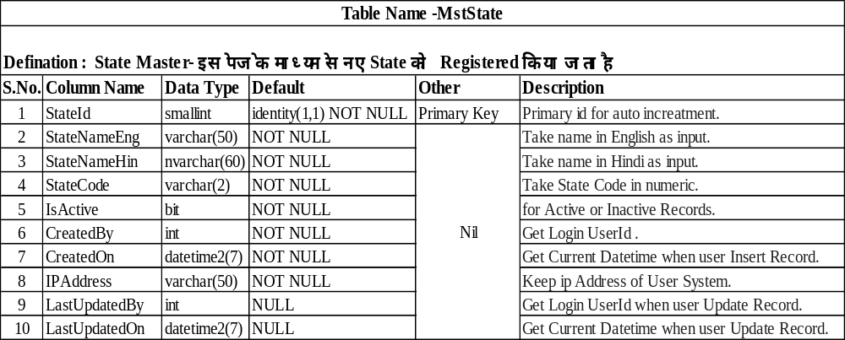
1. Master Tables
State Master

Slide 8
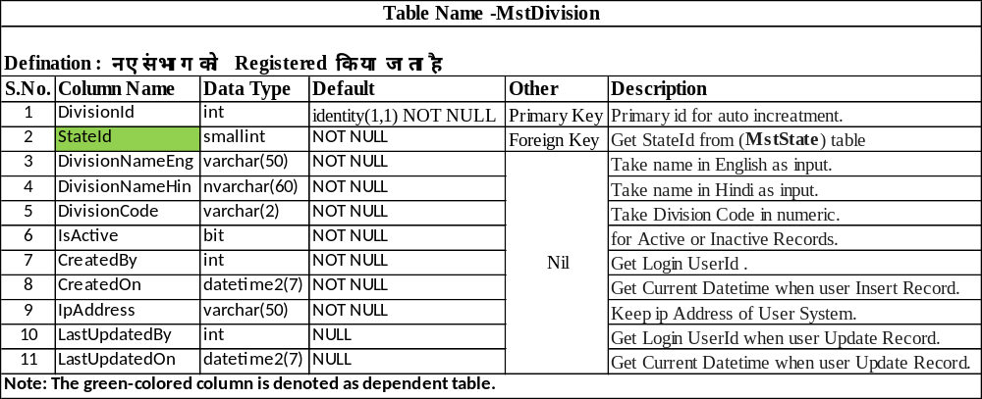
Division Master

Slide 9
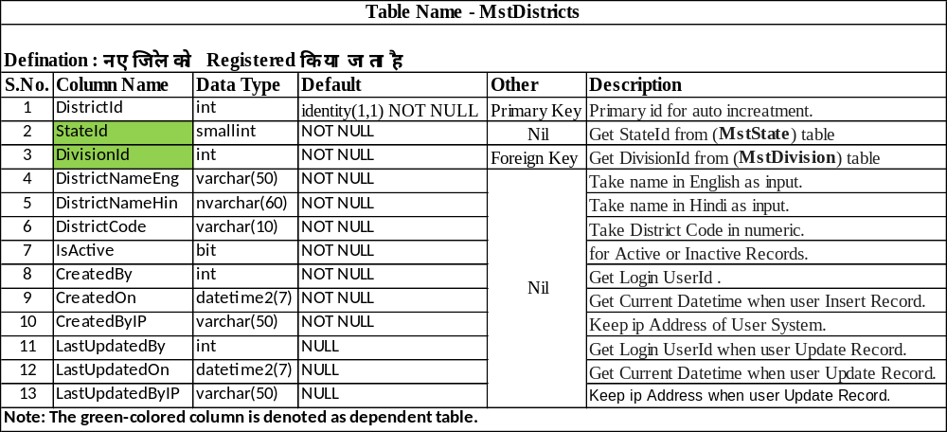
District Master

Slide 10
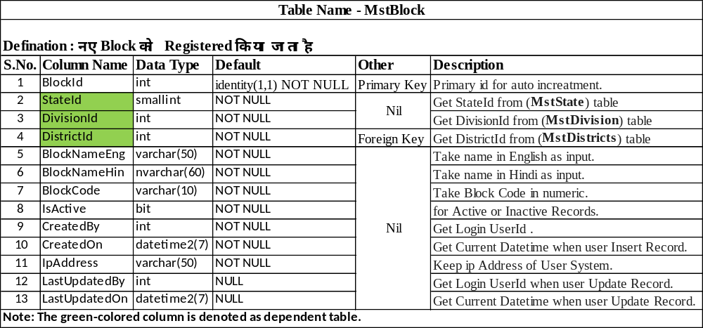
Block Master

Slide 11
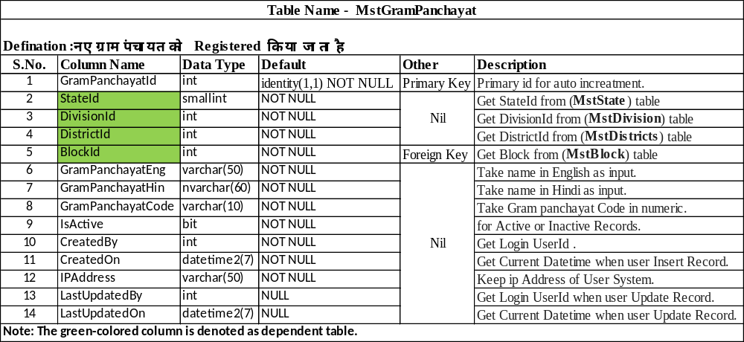
Gram Panchayat Master

Slide 12
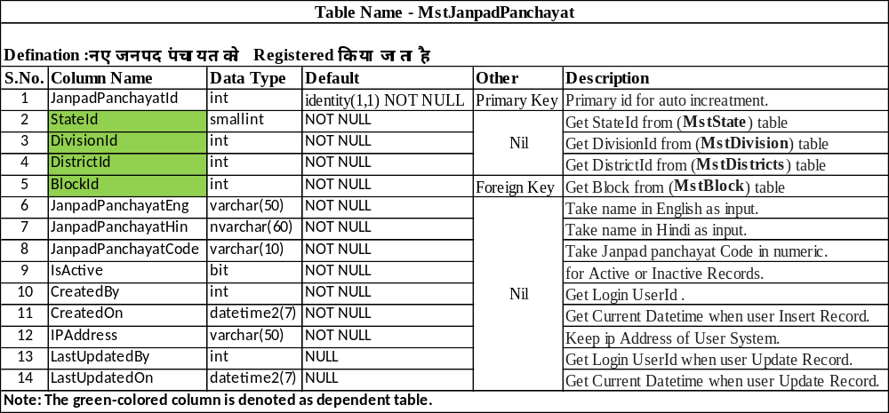
Janpad Panchayat Master

Slide 13
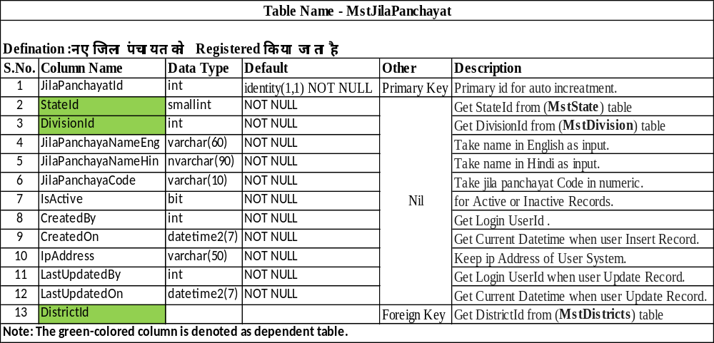
Jila Panchayat Master

Slide 14
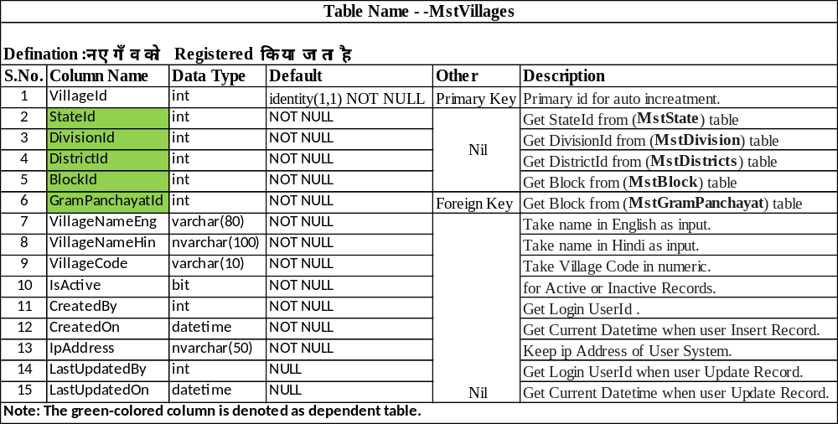
Village Master

Slide 15
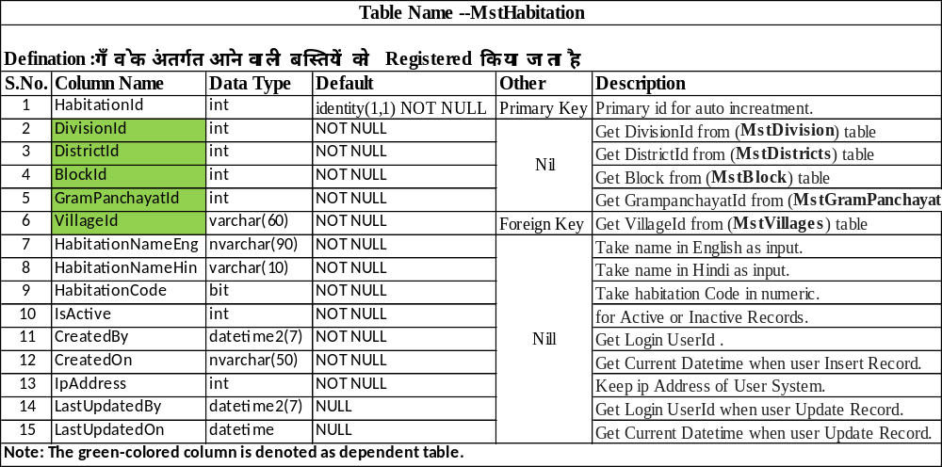
Habitation Master

Slide 16
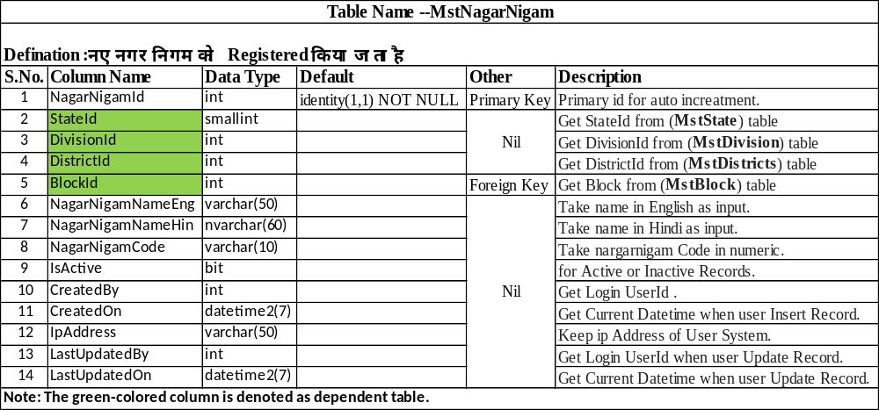
Nagar Nigam Master

Slide 17
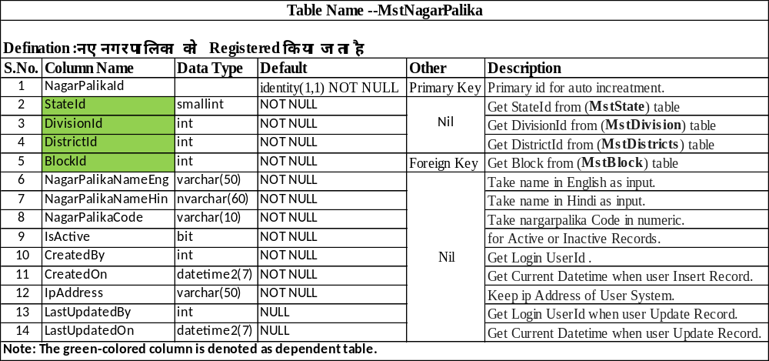
Nagar Palika Master

Slide 18
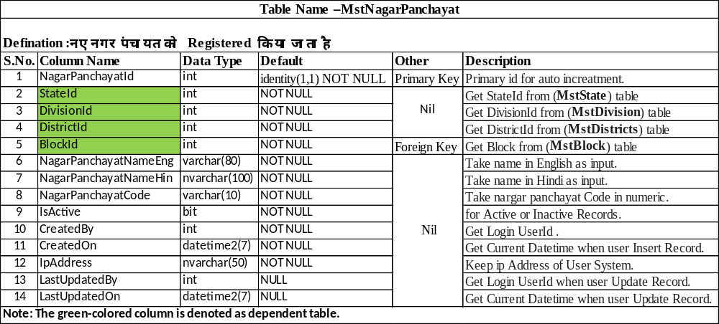
Nagar Panchayat Master

Slide 19
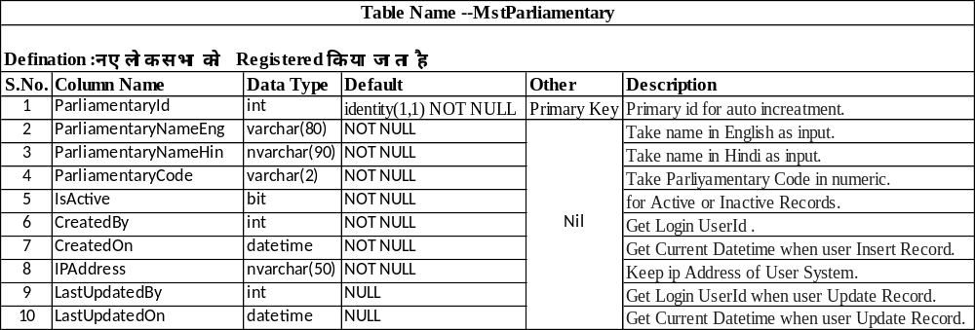
Parliamentary Master

Slide 20
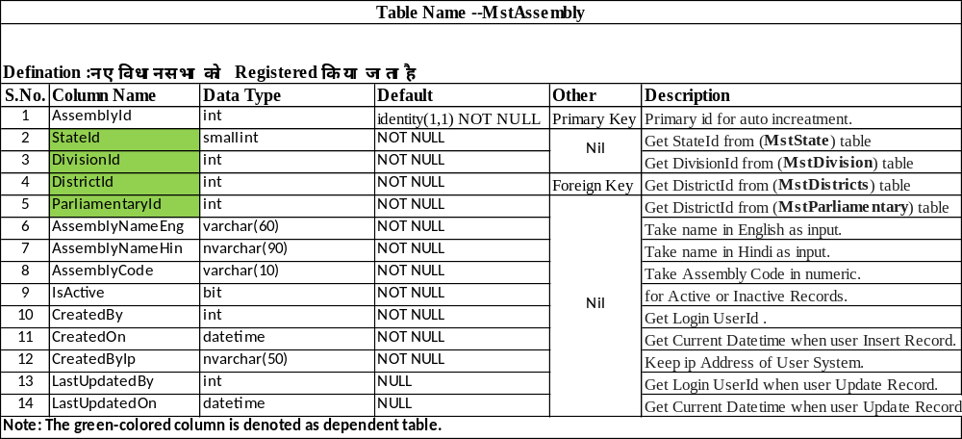
Assembly Master

Slide 21
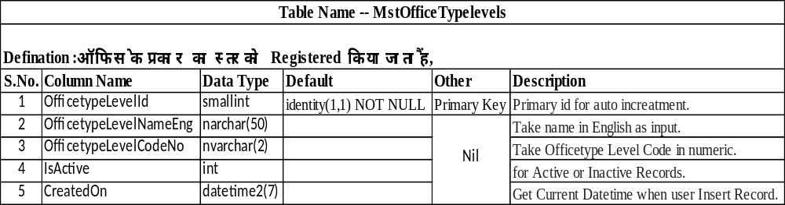
Office Type level Master

Slide 22
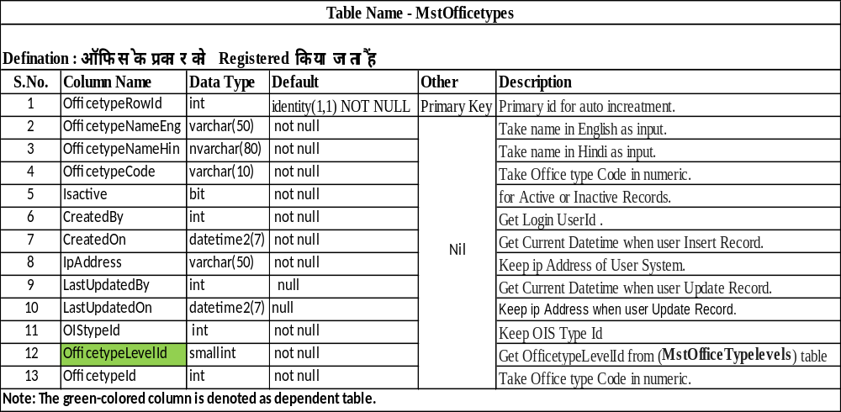
Office Type Master

Slide 23
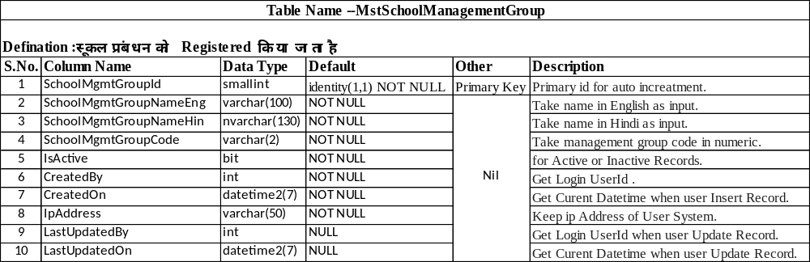
School Management Group Master

Slide 24
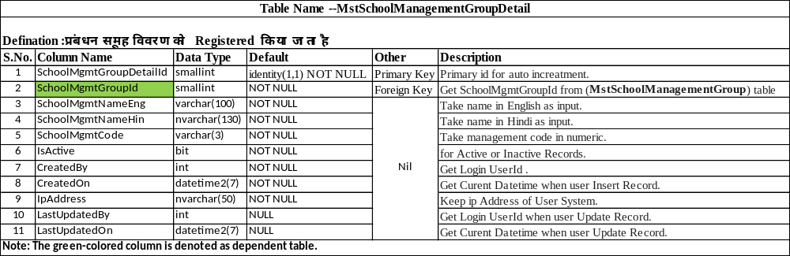
Management Group Details Master

Slide 25
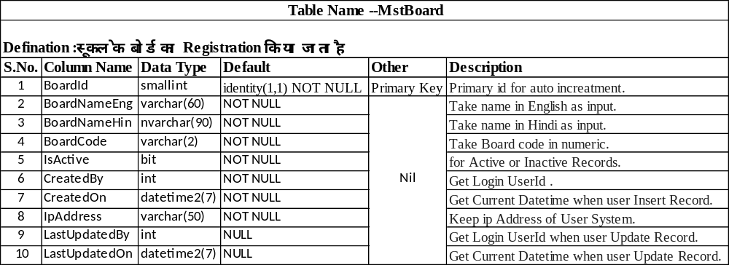
School Board Master

Slide 26
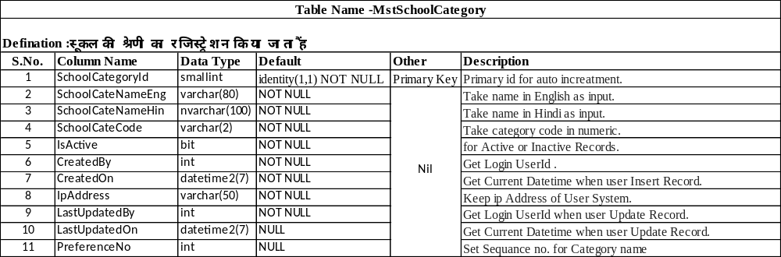
School Category Master

Slide 27
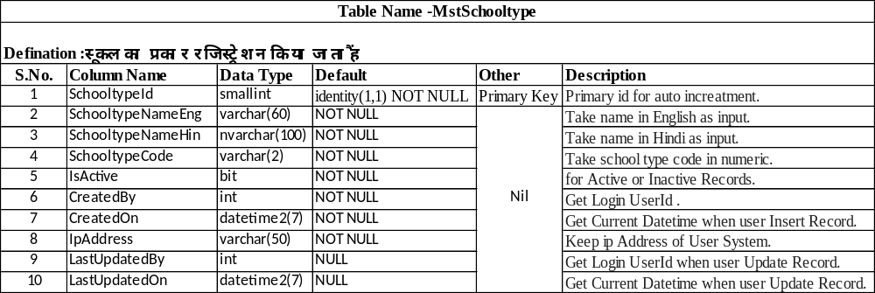
School Type Master

Slide 28
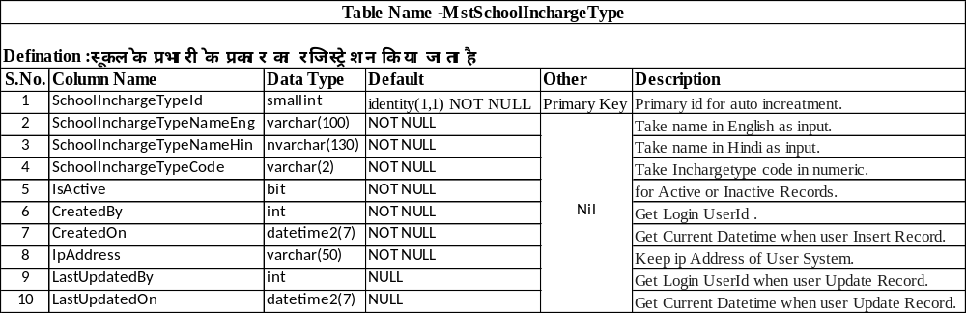
School Incharge Type Master

Slide 29
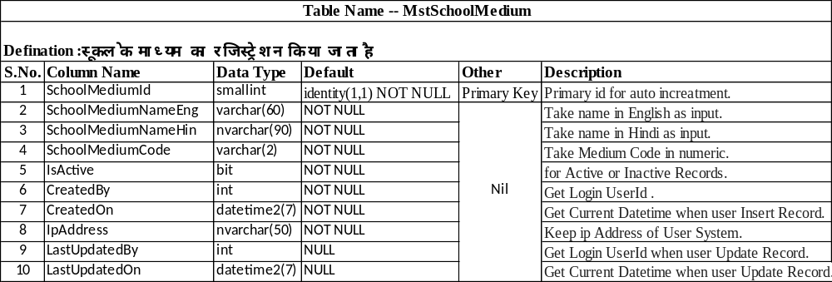
School Medium Master

Slide 30
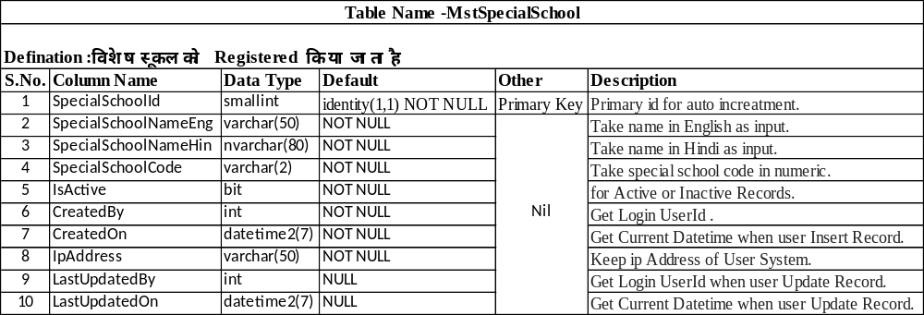
Special School Master

Slide 31
School Type Master

Slide 32
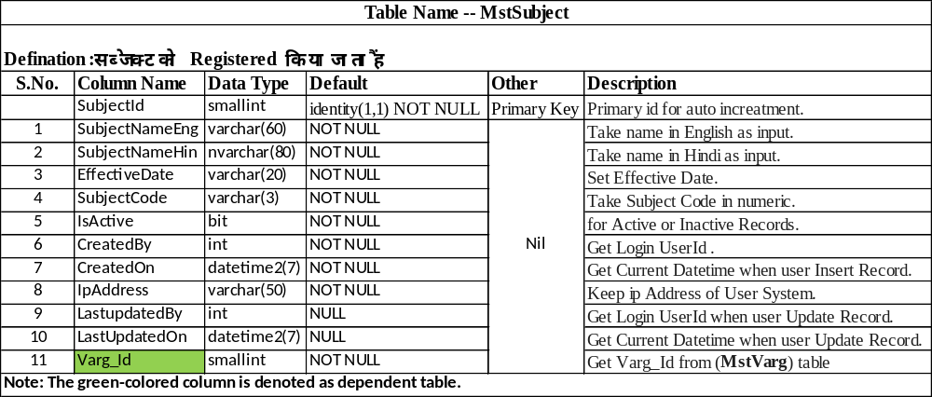
Subject Master

Slide 33
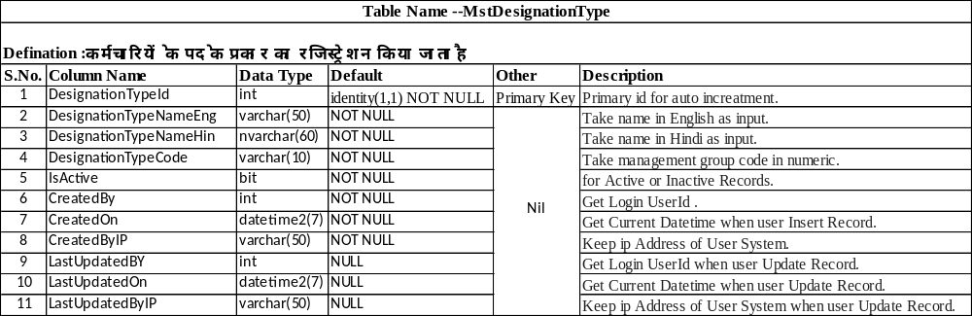
Designation Type Master

Slide 34
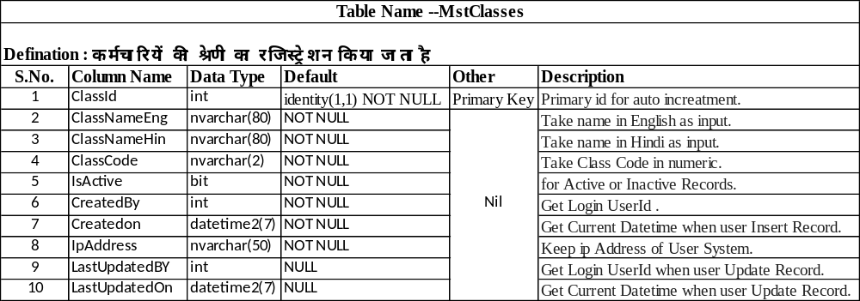
Employee Class Master

Slide 35
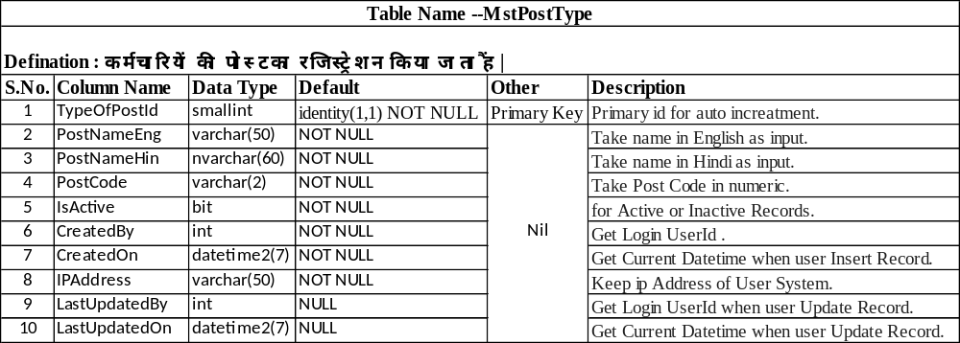
Post Type Master

Slide 36
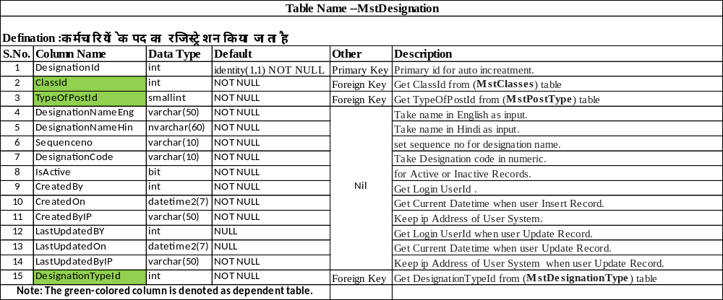
Designation Master

Slide 37
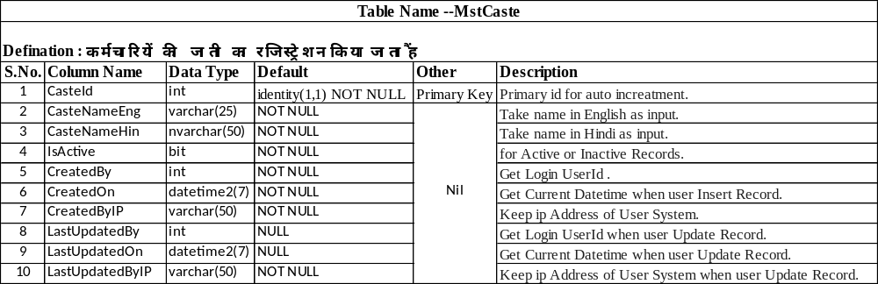
Caste Master

Slide 38
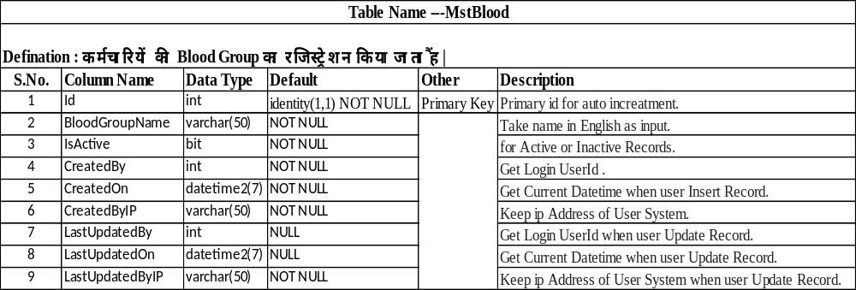
Blood Master

Slide 39
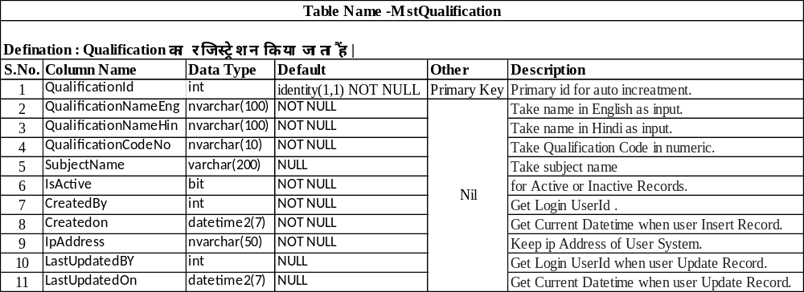
Qualification Master

Slide 40
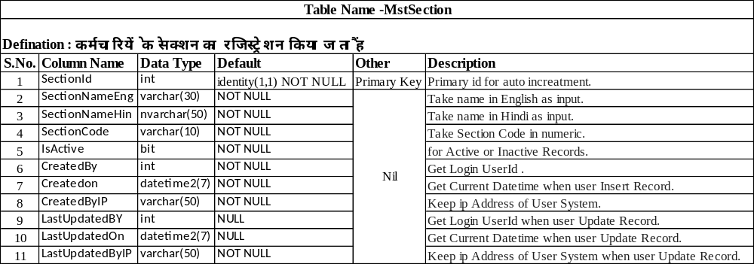
Section Master

Slide 41
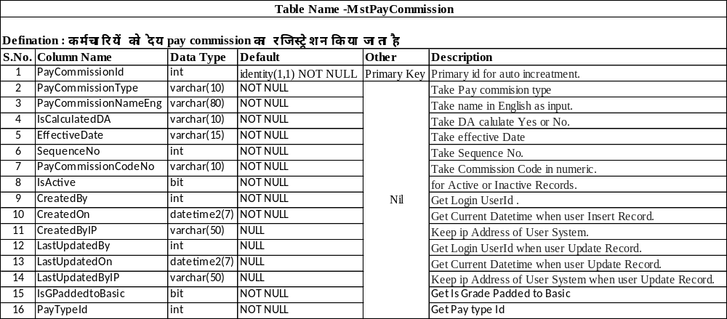
Pay Commission Master

Slide 42
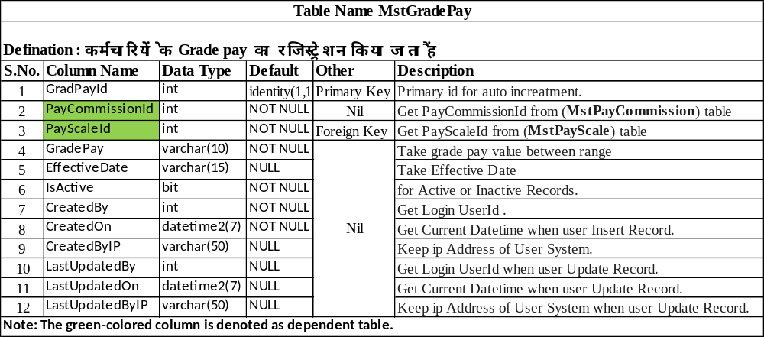
Grade Pay Master

Slide 43
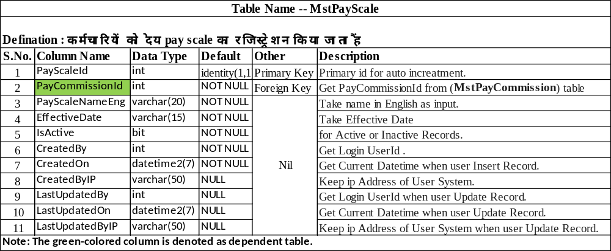
Pay Scale Master

Slide 44
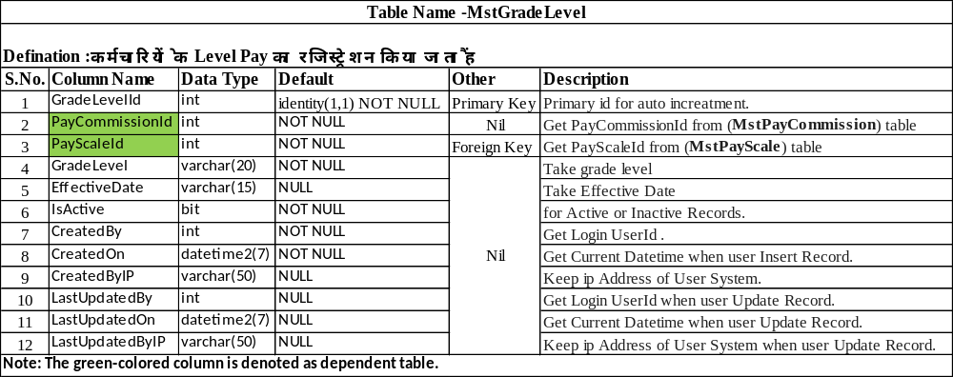
Grade Level Master

Slide 45
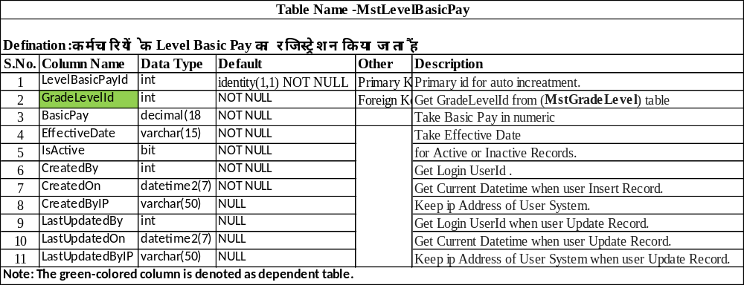
Level Basic Pay Master

Slide 46
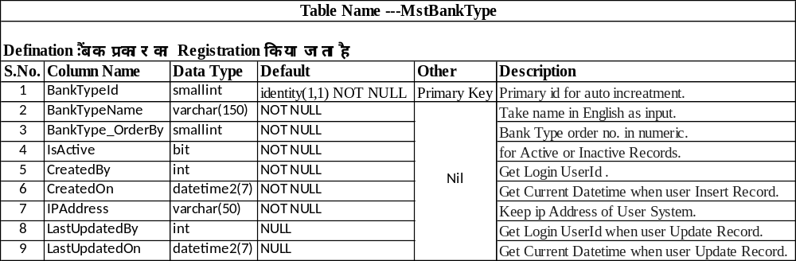
Bank Type Master

Slide 47
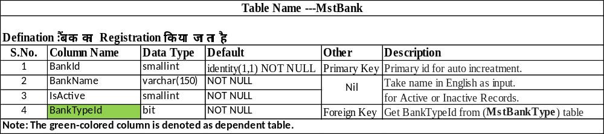
Bank Master

Slide 48
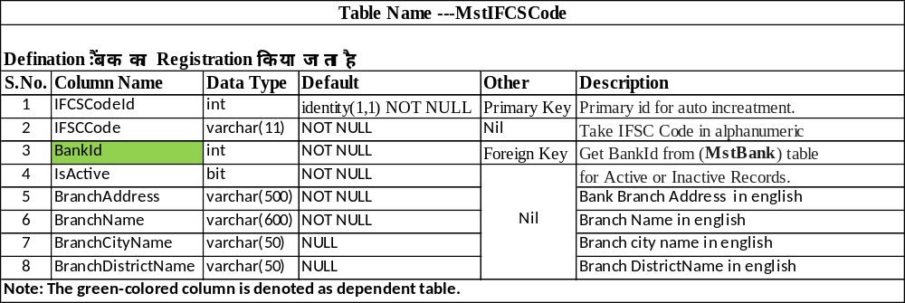
IFSC Code Master

Slide 49
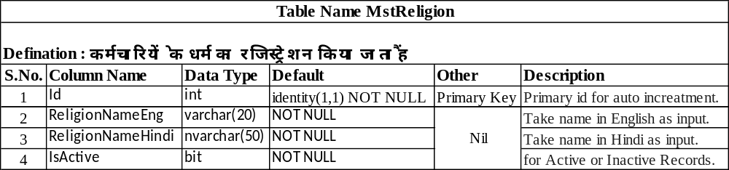
Religion Master

Slide 50
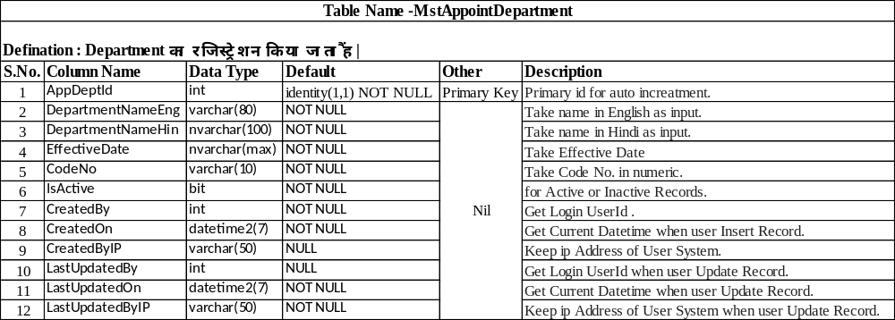
Appointment Department Master

Slide 51
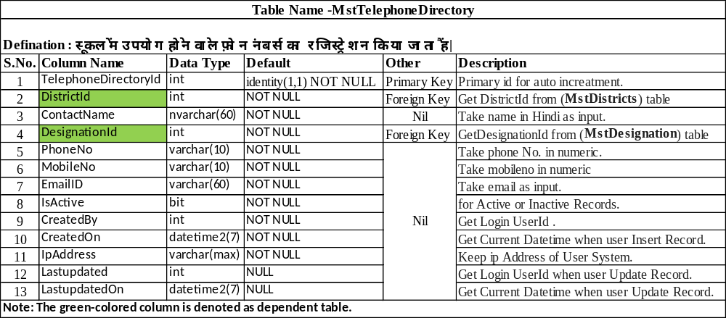
Telephone Directory Master

Slide 52
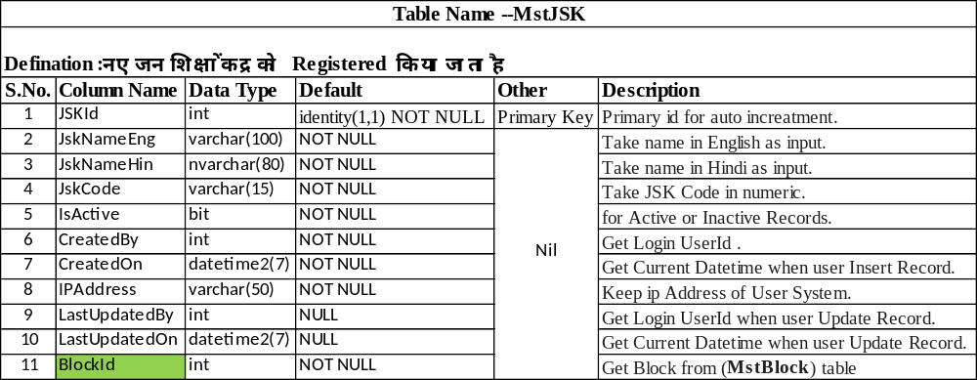
JSK Master

Slide 53
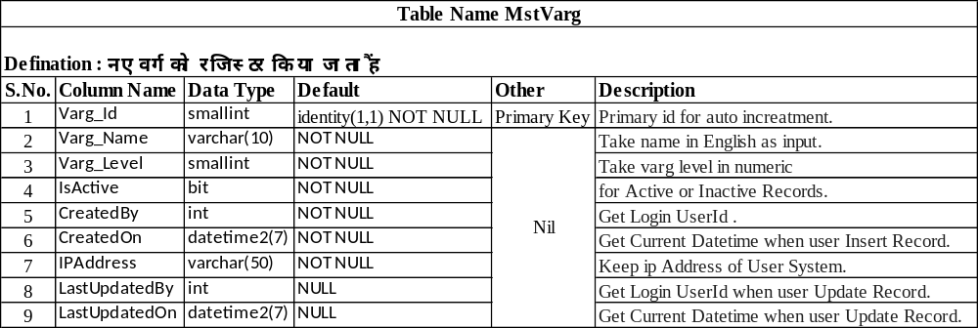
Varg Master

Slide 54
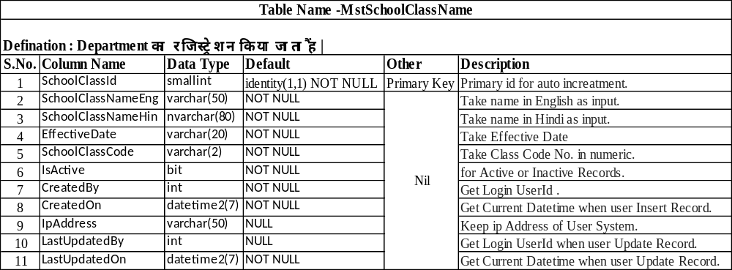
School Class Master

Slide 55
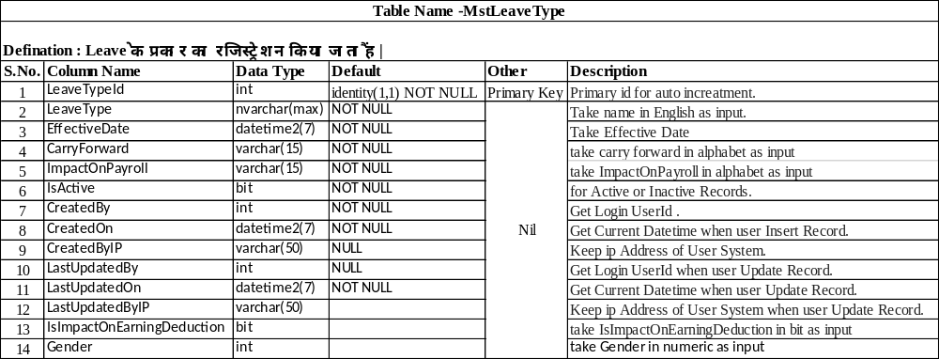
Leave Type Master

Slide 56
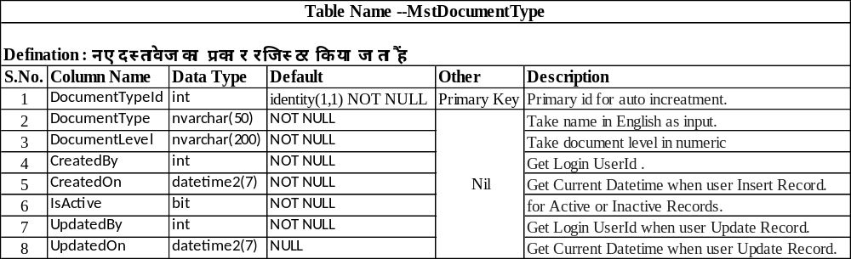
Document Type Master

Slide 57
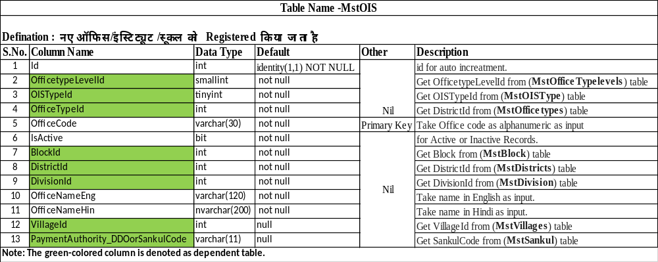
OIS Master

Slide 58

Criticalillness Type Master

Slide 59

Authority Objection Type Master

Slide 60

Class To Subject Type Master

Slide 61

Compassion Document Type Master

Slide 62

Complaint Topics Type Master

Slide 63

Complaint Type Master

Slide 64

Institute Registration Type Master-Part 01

Slide 65

Institute Registration Type Master-Part 02

Slide 66

Month Master

Slide 67

Panel Master

Slide 68

Panel Designation Mapping Master

Slide 69

Panel Group Master

Slide 70

Priority Master

Slide 71

Scheme Master

Slide 72

School Registration Master –Part 01

Slide 73

School Registration Master-Part 02

Slide 74

Student Registration Master-Part 01

Slide 75

Student Registration Master-Part 02

Slide 76

Apply Leave Master-Part 01

Slide 77

Apply Leave Master-Part 02

Slide 78

Varg Designation Mapping Master

Slide 79

Varg School Sub Category Mapping Master

Slide 80

Varg Subject Mapping Master

Slide 81

OIS Transfer Process-Part 01

Slide 82

OIS Transfer Process-Part 02

Slide 83

Office Setup

Slide 84

Post Code

Slide 85

Institute Setup

Slide 86

Employee Transfer Approval

Slide 87

Employee Transfer Location

Slide 88

Leave Allocation Type

Slide 89

Annual Confidential Report Master

Slide 90

Applicant Marital Stetus Master

Slide 91

Primary Teacher Degree Master

Slide 92

Relation With Prev Employee Master

Slide 93

Office Registration Master

Slide 94

Student Admission

Slide 95

Document Store

Slide 96

Handicapped Percentage Master

Slide 97

Sankul To School Mapping

Slide 98

Handicapped Type Master

Slide 99

School Close Process

Slide 100

School Merge Request

Slide 101

School Verification Process

Slide 102

Category Master

Slide 103

UnMapp School From Sankul

Slide 104

School Setup

Slide 105

Sankul Master

Slide 106

School UnMerge Request

Slide 107
CMS (HRMS) -Album
Table Name -Album
Defination : इस फॉर्म के माद्यम
S.No. | Column Name | Data Type | Default | Other | Description
1 | AlbumId | int | IDENTITY (1,1) | PRIMARY KEY | Primary id for auto increatment.
2 | OfficeId | int | NULL |  | Get OfficeId (MstOIS) in Numaric
3 | AlbumName | nvarchar(200) | NULL |  | Take Album Name as Input
4 | Detail | nvarchar(500) | NULL |  | Take Album Details as Input
5 | Albumdate | datetime2 | NOT NULL |  | Take input as date
6 | IsActive | bit | NOT NULL |  | For active or inactive record.
7 | CreatedBy | int | NULL |  | Get Login UserId .
8 | CreatedOn | datetime2 | NULL |  | Get Current Datetime when user Insert Record.
9 | IPAddress | varchar(50) | NULL |  | Keep IP Address of User System.
10 | LastUpdatedBy | int | NULL |  | Get Current Datetime when user Update Record.
11 | LastUpdatedOn | datetime2 | NULL |  | Get CurrentIP when user Update Record.
12 | LastUpdateByIp | varchar(50) | NULL |  | Get Login UserUd when User Update Record By IP Address.
Note: The Green-colored column is donated as dependent table

Slide 108
CMS (HRMS) -AlbumChild
Table Name -AlbumChild
Defination :
S.No. | Column Name | Data Type | Default | Other | Description
1 | ChildId | int | IDENTITY (1,1) | PRIMARY KEY | Primary id for auto increatment.
2 | AlbumId | int | NOT NULL |  | Get Albumid (Album) in Numaric
3 | ImgPath | varchar(50) | NULL |  | Get ImagePath Comma Separated
4 | IsActive | bit | NOT NULL |  | For active or inactive record.
Note: The Green-colored column is donated as dependent table

Slide 109
CMS (HRMS) -CircularOrder
Table Name - CircularOrder
Defination :
S.No. | Column Name | Data Type | Default | Other | Description
1 | CirularId | int | IDENTITY (1,1) | PRIMARY KEY | Primary id for auto increatment.
2 | OfficeId | int | NULL |  | Get OfficeId (MstOIS) in Numaric
3 | CirularNumber | nvarchar(MAX) | NOT NULL |  | Take CirularNumber as String.
4 | IssueDate | datetime2 | NOT NULL |  | Take input as date
5 | IssueBy | int | NOT NULL |  | Get IssueBy (MstDesignationType) in Numaric
6 | CategoryID | int | NOT NULL |  | Get CategoryID (MstCategory) in Numaric
7 | FromWhom | int | NOT NULL
8 | Priority | int | NOT NULL |  | Get Priority (MstPriority) in Numaric
9 | CircularFile | varchar(MAX) | NULL |  | Take ImagePath as String.
10 | Subject | nvarchar(400) | NOT NULL |  | Take Subject as String.
11 | IsActive | bit | NOT NULL |  | For active or inactive record.
12 | CreatedBy | int | NOT NULL |  | Get Login UserId .
13 | CreatedOn | datetime2 | NOT NULL |  | Get Current Datetime when user Insert Record.
14 | CreatedByIp | varchar(50) | NULL |  | Keep IP Address of User System.
15 | LastUpdateBy | int | NULL |  | Get Current Datetime when user Update Record.
16 | LastUpdateOn | datetime2 | NULL |  | Get CurrentIP when user Update Record.
17 | LastUpdateByIp | varchar(50) | NULL |  | Get Login UserUd when User Update Record By IP Address.
18 | CircularTitle | nvarchar(MAX) | NULL |  | Take CircularTitle as String.
Note: The Green-colored column is donated as dependent table

Slide 110
CMS (HRMS) -CircularOrderChild
Table Name - CircularOrderChild
Defination :
S.No. | Column Name | Data Type | Default | Other | Description
1 | CircularChildId | int | IDENTITY (1,1) | PRIMARY KEY | Primary id for auto increatment.
2 | Circularid | int | NOT NULL |  | Get Circularid (MstDesignationType) in Numaric
3 | CircularModuleId | int | NULL |  | Get CircularModuleId (MstCircularModule) in Numaric
4 | IsActive | bit | NOT NULL |  | For active or inactive record.
Note: The Green-colored column is donated as dependent table

Slide 111
CMS (HRMS) -MstCircularModule
Table Name -MstCircularModule
Defination :
S.No. | Column Name | Data Type | Default | Other | Description
1 | CircularModuleId | int | IDENTITY (1,1) | PRIMARY KEY | Primary id for auto increatment.
2 | ModuleName | nvarchar(200) | NULL |  | Take ModuleName as String.
3 | IsActive | bit | NOT NULL |  | For active or inactive record.
4 | CreatedBy | int | NOT NULL |  | Get Login UserId .
5 | CreatedOn | datetime2 | NOT NULL |  | Get Current Datetime when user Insert Record.
6 | CreatedByIp | varchar(50) | NULL |  | Keep IP Address of User System.
7 | LastUpdateBy | int | NULL |  | Get Current Datetime when user Update Record.
8 | LastUpdateOn | datetime2 | NULL |  | Get CurrentIP when user Update Record.
9 | LastUpdatedByIp | varchar(50) | NULL |  | Get Login Userid when User Update Record By IP Address.

Slide 112
CMS (HRMS) -TenderType
Table Name -TenderType
Defination :
S.No. | Column Name | Data Type | Default | Other | Description
1 | Id | int | IDENTITY (1,1) | PRIMARY KEY | Primary id for auto increatment.
2 | Type | varchar(50) | NULL |  | Take Type as String.
3 | IsActive | bit | NULL |  | For active or inactive record.

Slide 113
CMS (HRMS) -TrnEventInformation
Table Name -TrnEventInformation
Defination :
S.No. | Column Name | Data Type | Default | Other | Description
1 | EventId | int | IDENTITY (1,1) | PRIMARY KEY | Primary id for auto increatment.
2 | EventName | nvarchar(100) | NULL |  | Take EventName as String.
3 | EventSubject | nvarchar(1000) | NULL |  | Take EventSubject as String.
4 | ContactDetails | nvarchar(200) | NULL |  | Take Contact No.as String.
5 | CategoryId | int | NULL |  | Get CategoryId (MstCategory) in Numaric
6 | OfficeId | int | NULL |  | Get OfficeId (MstOIS) in Numaric
7 | FromDate | datetime2 | NULL |  | Take input as date
8 | UploadEventFile | nvarchar(MAX) | NULL |  | Take input as date
9 | IsActive | bit | NOT NULL |  | For active or inactive record.
10 | CreatedBy | int | NULL |  | Get Login UserId .
11 | CreatedOn | datetime2 | NULL |  | Get Current Datetime when user Insert Record.
12 | CreatedByIP | varchar(50) | NULL |  | Keep IP Address of User System.
13 | LastUpdatedBY | int | NULL |  | Get Current Datetime when user Update Record.
14 | LastUpdatedOn | datetime2 | NULL |  | Get CurrentIP when user Update Record.
15 | LastUpdatedByIP | varchar(50) | NULL |  | Get Login UserUd when User Update Record By IP Address.
16 | ConPerEmailId | nvarchar(100) | NULL |  | Take EMail as String.
17 | ConPerMobileNo | nvarchar(24) | NULL |  | Take Contact No.as String.
18 | ConPerName | nvarchar(100) | NULL |  | Take Name as String.
19 | ToDate | datetime2 | NULL |  | Take input as date
20 | EventImage | nvarchar(80) | NULL |  | Take ImagePath as String.
Note: The Green-colored column is donated as dependent table

Slide 114
CMS (HRMS) -TrnMessageInformation
Table Name - TrnMessageInformation
Defination :
S.No. | Column Name | Data Type | Default | Other | Description
1 | MsgId | int | IDENTITY (1,1) | PRIMARY KEY | Primary id for auto increatment.
2 | MsgTital | nvarchar(200) | NULL |  | Take MessgaeTitle as String.
3 | MsgDetails | nvarchar(1000) | NULL |  | Take MessgaeDetails as String.
4 | OfficeTypeId | int | NULL |  | Get OfficeId (MstOIS) in Numaric
5 | PriorityId | int | NULL |  | Get PriorityId (MstPriority) in Numaric
6 | MsgDate | datetime2 | NULL |  | Take input as date
7 | UploadMsgFile | nvarchar(100) | NULL |  | Take ImagePath as String.
8 | IsActive | bit | NOT NULL |  | For active or inactive record.
9 | CreatedBy | int | NULL |  | Get Login UserId .
10 | CreatedOn | datetime2 | NULL |  | Get Current Datetime when user Insert Record.
11 | CreatedByIP | varchar(50) | NULL |  | Keep IP Address of User System.
12 | LastUpdatedBY | int | NULL |  | Get Current Datetime when user Update Record.
13 | LastUpdatedOn | datetime2 | NULL |  | Get CurrentIP when user Update Record.
14 | LastUpdatedByIP | varchar(50) | NULL |  | Get Login UserUd when User Update Record By IP Address.
Note: The Green-colored column is donated as dependent table

Slide 115
CMS (HRMS) -TrnNewsInformation
Table Name - TrnNewsInformation
Defination :
S.No. | Column Name | Data Type | Default | Other | Description
1 | NewsId | int | IDENTITY (1,1) | PRIMARY KEY | Primary id for auto increatment.
2 | NewsPaper | nvarchar(100) | NULL |  | Take NewspaperName as String.
3 | NewsDate | datetime2 | NULL |  | Take input as date
4 | NewsSubject | nvarchar(1000) | NULL |  | Take NewspaperSubject as String.
5 | NewsUploadedById | int | NULL |  | Get OfficeId (MstOIS) in Numaric
6 | PriorityId | int | NULL |  | Get PriorityID (MstPriority) in Numaric
7 | UploadNewsFile | nvarchar(MAX) | NULL |  | Take Image Path as String.
8 | IsActive | bit | NOT NULL |  | For active or inactive record.
9 | CreatedBy | int | NULL |  | Get Login UserId .
10 | CreatedOn | datetime2 | NULL |  | Get Current Datetime when user Insert Record.
11 | CreatedByIP | varchar(50) | NULL |  | Keep IP Address of User System.
12 | LastUpdatedBY | int | NULL |  | Get Current Datetime when user Update Record.
13 | LastUpdatedOn | datetime2 | NULL |  | Get CurrentIP when user Update Record.
14 | LastUpdatedByIP | varchar(50) | NULL |  | Get Login UserUd when User Update Record By IP Address.
15 | NewsTitle | nvarchar(140) | NULL |  | Take NewspaperTitle as String.
16 | OfficeId | int | NULL |  | Get OfficeId (MstOIS) in Numaric
Note: The Green-colored column is donated as dependent table

Slide 116
CMS (HRMS) -TrnOrderInformation
Table Name - TrnOrderInformation
Defination :
S.No. | Column Name | Data Type | Default | Other | Description
1 | OrderId | int | IDENTITY (1,1) | PRIMARY KEY | Primary id for auto increatment.
2 | OfficeId | int | NULL |  | Get OfficeId (MstOIS) in Numaric
3 | OrderNumber | nvarchar(80) | NULL |  | Take OrderNumber as String.
4 | Subject | nvarchar(400) | NULL |  | Take Subject as String.
5 | CategoryID | int | NULL |  | Get CategoryID (MstCategory) in Numaric
6 | IssueBy | int | NULL |  | Take input as date
7 | FromWhom | int | NULL
8 | Priority | int | NULL |  | Get Priorityid (MstPriority) in Numaric .
9 | IssueDate | datetime2 | NULL |  | Take input as date
10 | OrderFile | varchar(50) | NULL |  | Take ImagePath as String.
11 | IsActive | bit | NOT NULL |  | For active or inactive record.
12 | CreatedBy | int | NOT NULL |  | Get Login UserId .
13 | CreatedOn | datetime2 | NOT NULL |  | Get Current Datetime when user Insert Record.
14 | CreatedByIp | varchar(50) | NULL |  | Keep IP Address of User System.
15 | LastUpdateBy | int | NULL |  | Get Current Datetime when user Update Record.
16 | LastUpdateOn | datetime2 | NULL |  | Get CurrentIP when user Update Record.
17 | LastUpdateByIp | varchar(50) | NULL |  | Get Login UserUd when User Update Record By IP Address.
18 | OrderTitle | nvarchar(300) | NULL |  | Take OrderTitle as String.
Note: The Green-colored column is donated as dependent table

Slide 117
CMS (HRMS) -TrnTenderOrder
Table Name -TrnTenderOrder
Defination :
S.No. | Column Name | Data Type | Default | Other | Description
1 | TenderId | int | IDENTITY (1,1) | PRIMARY KEY | Primary id for auto increatment.
2 | OfficeId | int | NULL |  | Get OfficeId (MstOIS) in Numaric
3 | OfficeAddress | nvarchar(400) | NOT NULL |  | Take OfficeAddress as String.
4 | LastDate | datetime2 | NULL |  | Take input as date
5 | IssueDate | datetime2 | NULL |  | Take input as date
6 | RefNo | varchar(50) | NULL |  | Take RefNo as String.
7 | TenderTypeid | int | NULL |  | Get TenderTypeid (TenderType) in Numaric
8 | Title | nvarchar(100) | NULL |  | Take Tender Title as String.
9 | EMD | decimal(18,2) | NULL |  | Take EMD Value as Decimal
10 | DocumentCost | decimal(18,2) | NULL |  | Take DocumentCost Value as Decimal
11 | WorkDescription | nvarchar(600) | NULL |  | Take WorkDescription as String.
12 | IssueById | int | NULL |  | Get Login UserId .
13 | Name | nvarchar(200) | NULL |  | Take Name as String.
14 | Email | varchar(100) | NULL |  | Take Emailid as String.
15 | PhoneNo | varchar(13) | NULL |  | Take Mobile No. as String.
16 | MobileNo | varchar(10) | NULL |  | Take Mobile No. as String.
17 | TenderFile | varchar(50) | NULL |  | Take ImagePath as String.
18 | IsActive | bit | NOT NULL |  | For active or inactive record.
19 | CreatedBy | int | NULL |  | Get Login UserId .
20 | CreatedOn | datetime2 | NULL |  | Get Current Datetime when user Insert Record.
21 | IPAddress | varchar(50) | NULL |  | Keep IP Address of User System.
22 | LastUpdatedBy | int | NULL |  | Get Login UserId .
23 | LastUpdatedOn | datetime2 | NULL |  | Get Current Datetime when user Insert Record.
24 | LastUpdateByIp | varchar(50) | NULL |  | Keep IP Address of User System.
25 | DistrictId | int | NULL |  | Get DistrictId (MstDistrict) in Numaric
26 | Officeidbydistrict | int | NULL |  | Get Districtid (MstDistrict) in Numaric
27 | TenderAmmendmendFile | varchar(50) | NULL |  | Take ImagePath as String.
28 | TenderCancellationFile | varchar(50) | NULL |  | Take ImagePath as String.
Note: The Green-colored column is donated as dependent table

Slide 118
GMS(HRMS) –TrnAddGrievanceDetails
Table Name -TrnAddGrievanceDetails
Defination :
S.No. | Column Name | Data Type | Default | Other | Description
1 | GVID | int | Identity(1,1) | Primary Key | Primary id for auto increatment.
2 | OfficeId | int | Null |  | Get OfficeId (MstOIS) in Numaric
3 | DepartmentId | int | Null |  | Get Office Code (MstOIS) in Numaric
4 | DistrictId | int | Null |  | Get DistrictId (MstDistrict) in Numaric
5 | EmployeeId | int | Null |  | Get EmployeeId (MstEmployeeregistration) in Numaric
6 | EmpUniqueId | nvarchar(12) | Null |  | Get EmpUniqueId (MstEmployeeregistration) in String
7 | Email | nvarchar(MAX) | Null |  | Take Email As String.
8 | MobileNumber | nvarchar(MAX) | Null |  | Take Mobile Number As String.
9 | AlternateMobileNumber | nvarchar(MAX) | Null |  | Take Alternate Mobile Number As String.
10 | GrievanceTypeId | int | Null |  | Take GrievanceTypeId (MstComplainType) in Numaric .
11 | GrievanceTopic | int | Null |  | Take GrievanceTopic (MstComplainTopic) in Numaric .
12 | Status | nvarchar(MAX) | Null |  | Take Status As String.
13 | SupportingDocument | nvarchar(MAX) | Null |  | Take SupportingDocument Path As String
14 | ComplaintDetails | nvarchar(MAX) | Null |  | Take ComplaintDetails As String
15 | FirstApprovalStatus | int | Null |  | Take FirstApprovalStatus in Numaric .
16 | SecondApprovalStatus | int | Null |  | Take SecondApprovalStatus in Numaric .
17 | ThirdApprovalStatus | int | Null |  | Take ThirdApprovalStatus in Numaric .
18 | FourthApprovalStatus | int | Null |  | Take FourthApprovalStatus in Numaric .
19 | FinalStatus | int | Null |  | Take FinalStatus in Numaric .
20 | FirstApprovalDocument | nvarchar(MAX) | Null |  | Take FirstApprovalDocument Path In String
21 | IsActive | bit | Not Null |  | For active or inactive record.
22 | CreatedBy | int | Not Null |  | Get Login UserId .
23 | CreatedOn | datetime2 | Not Null |  | Get Current Datetime when user Insert Record.
24 | CreatedByIP | varchar(50) | Null |  | Keep IP Address of User System.
25 | LastUpdatedBy | int | Null |  | Get Login UserId .
26 | LastUpdatedOn | datetime2 | Null |  | Get Current Datetime when user Insert Record.
27 | LastUpdatedByIP | varchar(50) | Null |  | Keep IP Address of User System.
28 | PeriodEnd | datetime2 | Not Null |  | Take PeriodEnd Date
29 | PeriodStart | datetime2 | Not Null |  | Take PeriodStart Date

Slide 119
GMS(HRMS) - TrnAddGrievanceDetails
30 | SecondForwardingOffice | nvarchar(MAX) | Null |  | Get SecondForwardingOffice (MstOIS) in Numaric
31 | ForwardingOffice | nvarchar(MAX) | Null |  | Get ForwardingOffice (MstOIS) in Numaric
32 | FourthForwardingOffice | nvarchar(MAX) | Null |  | Get FourthForwardingOffice (MstOIS) in Numaric
33 | ThirdForwardingOffice | nvarchar(MAX) | Null |  | Get ThirdForwardingOffice (MstOIS) in Numaric
34 | FirstForwardingComments | nvarchar(MAX) | Null |  | Take FirstForwardingComments as String
35 | FirstForwardingDate | datetime2 | Null |  | Take as Date
36 | FourthForwardingComment | nvarchar(MAX) | Null |  | Take FourthForwardingComment as String
37 | FourthForwardingDate | datetime2 | Null |  | Take as Date
38 | SecondForwardingComment | nvarchar(MAX) | Null |  | Take SecondForwardingComment as String
39 | SecondForwardingDate | datetime2 | Null |  | Take as Date
40 | ThirdForwardingComment | nvarchar(MAX) | Null |  | Take ThirdForwardingComment as String
41 | ThirdForwardingDate | datetime2 | Null |  | Take as Date
42 | RejectionComment | nvarchar(MAX) | Null |  | Take RejectionComment as String
43 | RejectionDocument | nvarchar(MAX) | Null |  | Take Document path as String
44 | FirstSectionId | int | Null |  | Get FirstSectionId (MstSection) in Numaric
45 | FourthSectionId | int | Null |  | Get FourthSectionId (MstSection) in Numaric
46 | SecondSectionId | int | Null |  | Get SecondSectionId (MstSection) in Numaric
47 | ThirdSectionId | int | Null |  | Get ThirdSectionId (MstSection) in Numaric
48 | GMSID | nvarchar(MAX) | Null |  | Take GMSID as String.
49 | DeleteComment | nvarchar(MAX) | Null |  | Take DeleteComment as String
Note: The Green-colored column is donated as dependent table

Slide 120
GMS(HRMS) - MstGrievanceApproval
Table Name - MstGrievanceApproval
Defination :
S.No. | Column Name | Data Type | Default | Other | Description
1 | GrievanceApproverId | int | IDENTITY (1,1) | PRIMARY KEY | Primary id for auto increatment.
2 | FirstUserDesignationId | int | NOT NULL |  | Take FirstDesignationId (MstDesignation) in Numaric
3 | FirstAutoForwardLimit | int | NOT NULL |  | Take Numaric Value
4 | FirstApproverCategory | int | NOT NULL |  | Take Numaric Value
5 | SecondUserDesignationId | int | NOT NULL |  | Take SecondUserDesignationId (MstDesignation) in Numaric
6 | SecondAutoForwardLimit | int | NOT NULL |  | Take Numaric Value
7 | ThirdUserDesignationId | int | NULL |  | Take ThirdUserDesignationId (MstDesignation) in Numaric
8 | ThirdAutoForwardLimit | int | NULL |  | Take Numaric Value
9 | FourthUserDesignationId | int | NULL |  | Take FourthUserDesignationId(MstDesignation) in Numaric
10 | FourthAutoForwardLimit | int | NULL |  | Take Numaric Value
11 | IsActive | bit | NOT NULL |  | For active or inactive record.
12 | CreatedBy | int | NOT NULL |  | Get Login UserId .
13 | CreatedOn | datetime2 | NOT NULL |  | Get Current Datetime when user Insert Record.
14 | CreatedByIP | varchar(50) | NULL |  | Keep IP Address of User System.
15 | LastUpdatedBy | int | NULL |  | Get Current Datetime when user Update Record.
16 | LastUpdatedOn | datetime2 | NULL |  | Get CurrentIP when user Update Record.
17 | LastUpdatedByIP | varchar(50) | NULL |  | Get Login UserUd when User Update Record By IP Address.
18 | PeriodEnd | datetime2 | NOT NULL |  | Take PeriodEnd Date
19 | PeriodStart | datetime2 | NOT NULL |  | Take PeriodStart Date
Note: The Green-colored column is donated as dependent table

Slide 121
GFMS - MstGuestFacultyBoardUniversity
Table Name -MstGuestFacultyBoardUniversity
Defination :
S.No. | Column Name | Data Type | Default | Other | Description
1 | BoardUniversityID | int | IDENTITY (1,1) | PRIMARY KEY | Primary id for auto increatment.
2 | BoardUniversityName | nvarchar(500) | NULL |  | Take BoardUniversityName as String.
3 | QualificationID | int | NULL |  | Get QualificationID (MstGuestFacultyQualification) in Numaric
4 | IsActive | bit | NOT NULL |  | For active or inactive record.
5 | CreatedBy | int | NULL |  | Get Login UserId .
6 | CreatedOn | datetime2 | NULL |  | Get Current Datetime when user Insert Record.
7 | IpAddress | varchar(50) | NOT NULL |  | Keep IP Address of User System.
8 | LastUpdatedBy | int | NULL |  | Get Current Datetime when user Update Record.
9 | LastUpdatedOn | datetime2 | NULL |  | Get CurrentIP when user Update Record.
Note: The Green-colored column is donated as dependent table

Slide 122
GFMS - MstGuestFacultyCourse
Table Name -MstGuestFacultyCourse
Defination :
S.No. | Column Name | Data Type | Default | Other | Description
1 | CourseID | int | IDENTITY (1,1) | PRIMARY KEY | Primary id for auto increatment.
2 | CourseName | nvarchar(200) | NULL |  | Take CourseName as String.
3 | QualificationID | int | NULL |  | Get QualificationID (MstGuestFacultyQualification) in Numaric
4 | IsActive | bit | NOT NULL |  | For active or inactive record.
5 | CreatedBy | int | NULL |  | Get Login UserId .
6 | CreatedOn | datetime2 | NULL |  | Get Current Datetime when user Insert Record.
7 | IpAddress | varchar(50) | NOT NULL |  | Keep IP Address of User System.
8 | LastUpdatedBy | int | NULL |  | Get Current Datetime when user Update Record.
9 | LastUpdatedOn | datetime2 | NULL |  | Get CurrentIP when user Update Record.
Note: The Green-colored column is donated as dependent table

Slide 123
GFMS - MstGuestFacultyQualification
Table Name -MstGuestFacultyQualification
Defination :
S.No. | Column Name | Data Type | Default | Other | Description
1 | QualificationID | int | IDENTITY (1,1) | PRIMARY KEY | Primary id for auto increatment.
2 | QualificationName | nvarchar(200) | NULL |  | Take QualificationName as String.
3 | IsActive | bit | NOT NULL |  | For active or inactive record.
4 | CreatedBy | int | NULL |  | Get Login UserId .
5 | CreatedOn | datetime2 | NULL |  | Get Current Datetime when user Insert Record.
6 | IpAddress | varchar(50) | NOT NULL |  | Keep IP Address of User System.
7 | LastUpdatedBy | int | NULL |  | Get Current Datetime when user Update Record.
8 | LastUpdatedOn | datetime2 | NULL |  | Get CurrentIP when user Update Record.

Slide 124
GFMS - MstGuestFacultySubject
Table Name -MstGuestFacultySubject
Defination :
S.No. | Column Name | Data Type | Default | Other | Description
1 | SubjectID | int | IDENTITY (1,1) | PRIMARY KEY | Primary id for auto increatment.
2 | SubjectName | nvarchar(500) | NULL |  | Take SubjectName as String.
3 | CourseID | int | NULL |  | Get CourseID (MstGuestFacultyCourse) in Numaric
4 | IsActive | bit | NOT NULL |  | For active or inactive record.
5 | CreatedBy | int | NULL |  | Get Login UserId .
6 | CreatedOn | datetime2 | NULL |  | Get Current Datetime when user Insert Record.
7 | IpAddress | varchar(50) | NOT NULL |  | Keep IP Address of User System.
8 | LastUpdatedBy | int | NULL |  | Get Current Datetime when user Update Record.
9 | LastUpdatedOn | datetime2 | NULL |  | Get CurrentIP when user Update Record.
Note: The Green-colored column is donated as dependent table

Slide 125
GFMS -TrnChildGuestFacultyExperience
Table Name - TrnChildGuestFacultyExperience
Defination :
S.No. | Column Name | Data Type | Default | Other | Description
1 | ExperienceuniqueId | int | IDENTITY (1,1) | PRIMARY KEY | Primary id for auto increatment.
2 | GFMSId | int | NOT NULL |  | Get GFMSId (TrnGuestFacultyRegistration) in Numaric
3 | AcademicYear | varchar(50) | NULL |  | Take AcademicYear as String.
4 | PanelId | int | NOT NULL |  | Get PanelId (MstPanel) in Numaric
5 | ExperienceWorkInYear | varchar(50) | NOT NULL |  | Take OfficeAddress as String.
6 | SubjectId | int | NOT NULL |  | Get SubjectId (MstGuestFacultySubject) in Numaric
7 | ProfessionalQualificationScore | varchar(50) | NOT NULL |  | Take ProfessionalQualificationScore as String.
8 | QualifiedScore | varchar(50) | NOT NULL |  | Take QualifiedScore as String.
9 | DocUpload | nvarchar(400) | NULL |  | Take ImagePath as String.
10 | IsActive | bit | NOT NULL |  | For active or inactive record.
11 | CreatedBy | int | NOT NULL |  | Get Login UserId .
12 | CreatedOn | datetime2 | NOT NULL |  | Get Current Datetime when user Insert Record.
13 | CreatedByIP | varchar(50) | NOT NULL |  | Keep IP Address of User System.
14 | LastUpdatedBy | int | NULL |  | Get Login UserId .
15 | LastUpdatedOn | datetime2 | NULL |  | Get Current Datetime when user Insert Record.
16 | LastUpdatedByIP | varchar(50) | NOT NULL |  | Get Login UserUd when User Update Record By IP Address.
Note: The Green-colored column is donated as dependent table

Slide 126
GFMS -TrnChildGuestFacultyQualification
Table Name -TrnChildGuestFacultyQualification
Defination :
S.No. | Column Name | Data Type | Default | Other | Description
1 | QualificationuniqueId | int | IDENTITY (1,1) | PRIMARY KEY | Primary id for auto increatment.
2 | GFMSId | int | NOT NULL |  | Get GFMSId (TrnGuestFacultyRegistration) in Numaric
3 | AcademicYear | varchar(50) | NULL |  | Take AcademicYear as String.
4 | QualificationId | int | NOT NULL |  | Get QualificationId (MstGuestFacultyQualification) in Numaric
5 | BoardId | int | NOT NULL |  | Get BoardId (MstGuestFacultyBoardUniversity) in Numaric
6 | SubjectId | int | NULL |  | Get SubjectId (MstGuestFacultySubject) in Numaric
7 | PassingYear | int | NOT NULL |  | Take PassingYear as String.
8 | RollNumber | nvarchar(40) | NOT NULL |  | Take RollNumber as String.
9 | Percentage | decimal(18,2) | NOT NULL |  | Take Percentage as String.
10 | QualificationDoc | nvarchar(400) | NOT NULL |  | Take ImagePath as String.
11 | CreatedBy | int | NOT NULL |  | Get Login UserId .
12 | CreatedByIP | varchar(50) | NOT NULL |  | Get Current Datetime when user Insert Record.
13 | CreatedOn | datetime2 | NOT NULL |  | Keep IP Address of User System.
14 | IsActive | bit | NOT NULL |  | For active or inactive record.
15 | LastUpdatedBy | int | NULL |  | Get Login UserId .
16 | LastUpdatedByIP | varchar(50) | NOT NULL |  | Get Current Datetime when user Insert Record.
17 | LastUpdatedOn | datetime2 | NULL |  | Keep IP Address of User System.
18 | Omarks | int | NOT NULL |  | Take Omarks as Int .
19 | Subjectname | nvarchar(MAX) | NULL |  | Take Subjectname as String.
20 | Tmarks | int | NOT NULL |  | Take Tmarks as Int .
21 | CourseId | int | NOT NULL |  | Get OfficeId (MstOIS) in Numaric
Note: The Green-colored column is donated as dependent table

Slide 127
GFMS -TrnGuestFacultyRegistration
Table Name - TrnGuestFacultyRegistration
Defination :
S.No. | Column Name | Data Type | Default | Other | Description
1 | GFMSId | int | IDENTITY (1,1) | PRIMARY KEY | Primary id for auto increatment.
2 | GuestNameEng | nvarchar(100) | NOT NULL |  | Take GuestNameEng as String.
3 | GuestNameHindi | nvarchar(100) | NOT NULL |  | Take GuestNameHindi as String.
4 | Gender | nvarchar(100) | NOT NULL |  | Get Gender (MstGender) in Numaric
5 | MobileNo | varchar(10) | NOT NULL |  | Take MobileNo as String.
6 | Dob | datetime2 | NOT NULL |  | Take input as date
7 | FatherName | nvarchar(100) | NOT NULL |  | Take FatherName as String.
8 | MotherName | nvarchar(100) | NOT NULL |  | Take MotherName as String.
9 | FamilySamagraIdNo | varchar(10) | NULL |  | Take FamilySamagraIdNo as String.
10 | SamagraIdNo | varchar(20) | NULL |  | Take SamagraIdNo as String.
11 | AadharNumber | varchar(20) | NULL |  | Take AadharNumber as String.
12 | MarritalStatus | int | NOT NULL |  | Get MarritalStatus (MstApplicantMartialStatus) in Numaric
13 | Email | varchar(50) | NULL |  | Take Email as String.
14 | StateId | int | NULL |  | Get StateId (MstState) in Numaric
15 | DivisionId | int | NULL |  | Get DivisionId (MstDivision) in Numaric
16 | DistrictId | int | NULL |  | Get DistrictId (MstDistricts) in Numaric
17 | BlockId | int | NULL |  | Get BlockId (MstBlock) in Numaric
18 | VillageId | int | NULL |  | Get VillageId (MstVillages) in Numaric
19 | Pincode | varchar(6) | NOT NULL |  | Take Pincode as String.
20 | Address | nvarchar(1000) | NOT NULL |  | Take Address as String.
21 | CreatedBy | int | NULL |  | Get Login UserId .
22 | CreatedByIP | varchar(50) | NULL |  | Keep IP Address of User System.
23 | CreatedOn | datetime2 | NULL |  | Get Current Datetime when user Insert Record.
24 | IsActive | bit | NOT NULL |  | For active or inactive record.
25 | LastUpdatedBy | int | NULL |  | Get Login UserId .
26 | LastUpdatedByIP | varchar(50) | NULL |  | Keep IP Address of User System.
27 | LastUpdatedOn | datetime2 | NULL |  | Get Current Datetime when user Insert Record.
28 | Sankulstatus | nvarchar(100) | NULL |  | Take Sankulstatus as String.
29 | Category | nvarchar(100) | NOT NULL |  | Take Category as Int.
30 | IsGovtRetired | bit | NOT NULL |  | For IsGovtRetired check.
31 | RejectionReason | nvarchar(400) | NULL |  | Take RejectionReason as String.
32 | RetiredSchoolUdiseCode | nvarchar(22) | NULL |  | Take RetiredSchoolUdiseCode as String.
33 | RetirementDate | datetime2 | NOT NULL |  | Take input as date
34 | VerifiedBySankul | nvarchar(20) | NULL |  | Take VerifiedBySankul as String.
Note: The Green-colored column is donated as dependent table

Slide 128
Hostel Management -MstHostelCategories
Table Name - MstHostelCategories
Defination :
S.No. | Column Name | Data Type | Default | Other | Description
1 | HostelChildId | int | IDENTITY (1,1) | PRIMARY KEY | Primary id for auto increatment.
2 | HostelId | int | NOT NULL |  | Get HostelId (TrnHostelRegistration) in Numaric
3 | CategoryId | int | NOT NULL |  | Get CategoryId (MstHostelCategories) in Numaric
4 | IsActive | bit | NOT NULL |  | For active or inactive record.
Note: The Green-colored column is donated as dependent table

Slide 129
Hostel Management -MstHostelMessFees
Table Name -MstHostelMessFees
Defination :
S.No. | Column Name | Data Type | Default | Other | Description
1 | FeesId | int | IDENTITY (1,1) | PRIMARY KEY | Primary id for auto increatment.
2 | HostelId | int | NOT NULL |  | Get HostelId (TrnHostelRegistration) in Numaric
3 | IsActive | bit | NOT NULL |  | For active or inactive record.
4 | MessFeeAmt | decimal(18,2) | NOT NULL |  | Take input as date
5 | ApplicableFromDate | datetime | NOT NULL |  | Take input as date
6 | ApplicableToDate | datetime | NULL |  | Take input as date
7 | CreatedBy | int | NOT NULL |  | Get Login UserId .
8 | CreatedOn | datetime2 | NOT NULL |  | Get Current Datetime when user Insert Record.
9 | CreatedByIP | varchar(20) | NOT NULL |  | Keep IP Address of User System.
Note: The Green-colored column is donated as dependent table

Slide 130
Hostel Management -MstRoomRegistration
Table Name - MstRoomRegistration
Defination :
S.No. | Column Name | Data Type | Default | Other | Description
1 | RoomId | int | IDENTITY (1,1) | PRIMARY KEY | Primary id for auto increatment.
2 | RoomTypeId | int | NOT NULL |  | Get RoomTypeId (MstRoomType) in Numaric
3 | HostelId | int | NOT NULL |  | Get HostelId (TrnHostelRegistration) in Numaric
4 | RoomNo | varchar(5) | NOT NULL |  | Take RoomNo as String.
5 | IsActive | bit | NOT NULL |  | For active or inactive record.
6 | CreatedBy | int | NOT NULL |  | Get Login UserId .
7 | CreatedOn | datetime2 | NOT NULL |  | Get Current Datetime when user Insert Record.
8 | CreatedByIP | varchar(20) | NOT NULL |  | Keep IP Address of User System.
Note: The Green-colored column is donated as dependent table

Slide 131
Hostel Management -MstRoomRegistrationChild
Table Name - MstRoomRegistrationChild
Defination :
S.No. | Column Name | Data Type | Default | Other | Description
1 | BedId | int | IDENTITY (1,1) | PRIMARY KEY | Primary id for auto increatment.
2 | RoomId | int | NOT NULL |  | Get RoomId (MstRoomType) in Numaric
3 | RoomTypeId | int | NOT NULL |  | Get RoomTypeId (MstRoomType) in Numaric
4 | BedNo | varchar(7) | NOT NULL |  | Take BedNo as String.
5 | IsAllocated | bit | NOT NULL |  | For IsAllocated Check.
6 | IsActive | bit | NOT NULL |  | For active or inactive record.
7 | CreatedBy | int | NOT NULL |  | Get Login UserId .
8 | CreatedOn | datetime2 | NOT NULL |  | Get Current Datetime when user Insert Record.
9 | CreatedByIP | varchar(20) | NOT NULL |  | Keep IP Address of User System.
Note: The Green-colored column is donated as dependent table

Slide 132
Hostel Management -MstRoomType
Table Name - MstRoomType
Defination :
S.No. | Column Name | Data Type | Default | Other | Description
1 | RoomTypeId | int | IDENTITY (1,1) | PRIMARY KEY | Primary id for auto increatment.
2 | HostelId | int | NOT NULL |  | Get HostelId (TrnHostelRegistration) in Numaric
3 | RoomTypeName | varchar(30) | NOT NULL |  | Take RoomTypeName as String.
4 | NoOfBed | tinyint | NOT NULL |  | Take NoOfBed as Numaric
5 | IsActive | bit | NOT NULL |  | For active or inactive record.
6 | CreatedBy | int | NOT NULL |  | Get Login UserId .
7 | CreatedOn | datetime2 | NOT NULL |  | Get Current Datetime when user Insert Record.
8 | CreatedByIP | varchar(20) | NOT NULL |  | Keep IP Address of User System.
Note: The Green-colored column is donated as dependent table

Slide 133
Hostel Management -MstRoomTypeChild
Table Name - MstRoomTypeChild
Defination :
S.No. | Column Name | Data Type | Default | Other | Description
1 | RoomTypeChildId | int | IDENTITY (1,1) | PRIMARY KEY | Primary id for auto increatment.
2 | RoomTypeId | int | NOT NULL |  | Get RoomTypeId (MstRoomType) in Numaric
3 | CategoryId | int | NOT NULL |  | Take CategoryId as Int.
4 | RentPerBedAmt | decimal(18,2) | NOT NULL |  | Take RentPerBedAmt in decimal.
5 | ApplicableFromDate | datetime | NOT NULL |  | Take input as date
6 | ApplicableToDate | datetime | NULL |  | Take input as date
7 | IsActive | bit | NOT NULL |  | For active or inactive record.
8 | CreatedBy | int | NOT NULL |  | Get Login UserId .
9 | CreatedOn | datetime2 | NOT NULL |  | Get Current Datetime when user Insert Record.
10 | CreatedByIP | varchar(20) | NOT NULL |  | Keep IP Address of User System.
Note: The Green-colored column is donated as dependent table

Slide 134
Hostel Management -TrnHostelRegistration
Table Name - TrnHostelRegistration
Defination :
S.No. | Column Name | Data Type | Default | Other | Description
1 | HostelId | int | IDENTITY (1,1) | PRIMARY KEY | Primary id for auto increatment.
2 | HostelNameEng | varchar(100) | NOT NULL |  | Take HostelNameEng as String.
3 | HostelNameHin | nvarchar(240) | NOT NULL |  | Take HostelNameHin as String.
4 | SchooltypeId | int | NOT NULL |  | Take SchooltypeId as Int.
5 | CastCategoryId | tinyint | NOT NULL |  | Get CastCategoryId (MstCaste) in Numaric
6 | HostelParentId | int | NOT NULL |  | Take School ID as Numric.
7 | HostelParentTypeId | int | NOT NULL |  | Take HostelParentTypeId as Int.
8 | HostelParentName | nvarchar(200) | NOT NULL |  | Take HostelParentName as String.
9 | HostelAddress | nvarchar(300) | NOT NULL |  | Take HostelAddress as String.
10 | InchargeName | nvarchar(100) | NOT NULL |  | Take InchargeName as String.
11 | InchargeMobileNo | varchar(10) | NOT NULL |  | Take InchargeMobileNo as String.
12 | HostelPhoneNo | varchar(12) | NOT NULL |  | Take HostelPhoneNo as String.
13 | NoOfRoom | int | NOT NULL |  | Take NoOfRoom as Numric
14 | CapacityOfStudents | int | NOT NULL |  | Take CapacityOfStudents as Numric
15 | IsMessFacility | bit | NOT NULL |  | For IsMessFacility have or Not .
16 | IsActive | bit | NOT NULL |  | For active or inactive record.
17 | CreatedBy | int | NOT NULL |  | Get Login UserId .
18 | CreatedOn | datetime2 | NOT NULL |  | Get Current Datetime when user Insert Record.
19 | CreatedByIP | varchar(20) | NOT NULL |  | Keep IP Address of User System.
20 | OISCode | nvarchar(22) | NOT NULL |  | Get OISCode (MstOIS) in Numaric
21 | OISTypeId | int | NOT NULL |  | Get OISTypeId (MstOIS) in Numaric
Note: The Green-colored column is donated as dependent table

Slide 135
Hostel Management -TrnStudentRoomAllocation
Table Name - TrnStudentRoomAllocation
Defination :
S.No. | Column Name | Data Type | Default | Other | Description
1 | RoomAllocationId | int | IDENTITY (1,1) | PRIMARY KEY | Primary id for auto increatment.
2 | StudentId | bigint | NOT NULL |  | Take StudentId as Int.
3 | Gender | tinyint | NOT NULL |  | Get Gender (MstGender) in Numaric
4 | CastCategoryId | tinyint | NOT NULL |  | Get CastCategoryId (MstCaste) in Numaric
5 | RoomId | int | NOT NULL |  | Get RoomId (MstRoomRegistration) in Numaric
6 | BedId | int | NOT NULL |  | Take BedId as Int.
7 | RentPerBedAmt | decimal(18,2) | NULL |  | Take RentPerBedAmt as Decimal
8 | AcademicYear | varchar(8) | NOT NULL |  | Take Financial Year as String.
9 | AllocationDealocationStatus | bit | NOT NULL |  | For AllocationDealocationStatus Check.
10 | IsActive | bit | NOT NULL |  | For active or inactive record.
11 | AllocatedBy | int | NULL |  | Get Login UserId .
12 | AllocatedOn | datetime2 | NULL |  | Get Current Datetime when user Insert Record.
13 | AllocatedByIP | varchar(20) | NULL |  | Keep IP Address of User System.
14 | DeAllocatedBy | int | NULL |  | Get Login UserId .
15 | DeAllocatedOn | datetime2 | NULL |  | Get Current Datetime when user Insert Record.
16 | DeAllocatedByIP | varchar(20) | NULL |  | Keep IP Address of User System.
17 | IsAvailingMessFacility | bit | NOT NULL |  | For IsAvailingMessFacility Check.
Note: The Green-colored column is donated as dependent table

Slide 136
PayRoll-MstTypeofAuthorityAction
Table Name - MstTypeofAuthorityAction
Defination :
S.No. | Column Name | Data Type | Default | Other | Description
1 | AuthorityActiontypeId | int | IDENTITY (1,1) | PRIMARY KEY | Primary id for auto increatment.
2 | ActiontypeNameEng | varchar(80) | NOT NULL |  | Take ActiontypeNameEng as String.
3 | ActiontypeNameHin | nvarchar(200) | NOT NULL |  | Take ActiontypeNameHin as String.

Slide 137
PayRoll-PrlMstEarnDed
Table Name - PrlMstEarnDed
Defination :
S.No. | Column Name | Data Type | Default | Other | Description
1 | EarnDeductionId | int | IDENTITY (1,1) | PRIMARY KEY | Primary id for auto increatment.
2 | HeadTypeId | smallint | NOT NULL |  | Get HeadTypeId (PrlMstHeadType) in Numaric
3 | EarnDeductionName | varchar(100) | NOT NULL |  | Take EarnDeductionName as String.
4 | CalculationId | int | NOT NULL |  | Get CalculationId (PrlMstEarnDedCalculation) in Numaric
5 | OrderBy | int | NOT NULL |  | Take OrderBy as int.
6 | EarnDeductionPriority | int | NOT NULL |  | Take EarnDeductionPriority as int.
7 | IsCalculatebetweenRange | bit | NOT NULL |  | For IsCalculatebetweenRange Check.
8 | IsOptional | bit | NOT NULL |  | For IsOptional Check.
9 | IsPolicy | bit | NOT NULL |  | For IsPolicy Check.
10 | IsLoan | bit | NOT NULL |  | For IsLoan Check.
11 | IsCommon | bit | NOT NULL |  | For IsCommon Check.
12 | IsMonthly | bit | NOT NULL |  | For IsMonthly Check.
13 | IsDa | bit | NOT NULL |  | For IsDa Check.
14 | IsImpactOnLeave | bit | NOT NULL |  | For IsImpactOnLeave Check.
15 | IsEpf | bit | NOT NULL |  | For IsEpf Check.
16 | IsNPS | bit | NOT NULL |  | For IsNPS Check.
17 | EffectiveDate | datetime | NOT NULL |  | Take input as date
18 | IsActive | bit | NOT NULL |  | For active or inactive record.
19 | CreatedBy | int | NOT NULL |  | Get Login UserId .
20 | CreatedOn | datetime2 | NOT NULL |  | Get Current Datetime when user Insert Record.
21 | CreatedByIp | varchar(50) | NOT NULL |  | Keep IP Address of User System.
22 | LastUpdatedBy | int | NULL |  | Get Login UserId .
23 | LastUpdatedOn | datetime2 | NULL |  | Get Current Datetime when user Insert Record.
24 | DesignationId | int | NOT NULL |  | Get DesignationId (MstDesignation) in Numaric
25 | DesignationTypeId | int | NOT NULL |  | Get DesignationTypeId (MstDesignationType) in Numaric
26 | PeriodEnd | datetime2 | NOT NULL |  | Take input as date
27 | PeriodStart | datetime2 | NOT NULL |  | Take input as date
28 | EarnDeductionHeadCode | varchar(20) | NOT NULL |  | Take EarnDeductionHeadCode as String.
29 | IsContribution | bit | NOT NULL |  | For IsContribution Check.
30 | IsTAX | bit | NOT NULL |  | For IsTAX Check.
31 | IsDPF | bit | NOT NULL |  | For IsDPF Check.
32 | IsGPF | bit | NOT NULL |  | For IsGPF Check.
33 | MaxHeadValue | decimal(18,2) | NULL |  | Take MaxHeadValue as Decimal.
34 | MinHeadValue | decimal(18,2) | NULL |  | Take MinHeadValue as Decimal.
Note: The Green-colored column is donated as dependent table

Slide 138
PayRoll-PrlMstEarnDedCalculation
Table Name - PrlMstEarnDedCalculation
Defination :
S.No. | Column Name | Data Type | Default | Other | Description
1 | CalculationId | int | IDENTITY (1,1) | PRIMARY KEY | Primary id for auto increatment.
2 | CalculationName | nvarchar(200) | NOT NULL |  | Take CalculationName as String.
3 | OrderBy | int | NOT NULL |  | Take OrderBy as int
4 | isActive | bit | NOT NULL |  | For active or inactive record.

Slide 139
PayRoll-PrlMstHeadType
Table Name - PrlMstHeadType
Defination :
S.No. | Column Name | Data Type | Default | Other | Description
1 | HeadTypeId | smallint | IDENTITY (1,1) | PRIMARY KEY | Primary id for auto increatment.
2 | HeadTypeNameEng | varchar(50) | NOT NULL |  | Take HeadTypeNameEng as String.
3 | HeadTypeNameHin | nvarchar(120) | NOT NULL |  | Take HeadTypeNameHin as String.
4 | IsActive | bit | NOT NULL |  | For active or inactive record.
5 | CreatedBy | int | NOT NULL |  | Get Login UserId .
6 | CreatedOn | datetime2 | NOT NULL |  | Get Current Datetime when user Insert Record.
7 | CreatedByIP | varchar(50) | NOT NULL |  | Keep IP Address of User System.
8 | LastUpdatedBy | int | NULL |  | Get Login UserId .
9 | LastUpdatedOn | datetime2 | NULL |  | Get Current Datetime when user Insert Record.
10 | LastUpdatedByIP | varchar(50) | NULL |  | Keep IP Address of User System.

Slide 140
PayRoll-PrlMstPeriod
Table Name - PrlMstPeriod
Defination :
S.No. | Column Name | Data Type | Default | Other | Description
1 | PeriodId | smallint | IDENTITY (1,1) | PRIMARY KEY | Primary id for auto increatment.
2 | PeriodName | nvarchar(MAX) | NOT NULL |  | Take PeriodName as String.
3 | PeriodOrderBy | smallint | NOT NULL |  | Take PeriodOrderBy as int.
4 | IsActive | bit | NOT NULL |  | For active or inactive record.

Slide 141
PayRoll-PrlMstSalaryStatus
Table Name - PrlMstSalaryStatus
Defination :
S.No. | Column Name | Data Type | Default | Other | Description
1 | StatusId | smallint | IDENTITY (1,1) | PRIMARY KEY | Primary id for auto increatment.
2 | SalaryStatus | varchar(30) | NOT NULL |  | Take SalaryStatus as String.
3 | SalaryStatusId | smallint | NOT NULL |  | Take SalaryStatusId as smallint.
4 | isActive | bit | NOT NULL |  | For active or inactive record.
5 | SalaryStatus_OrderBy | smallint | NOT NULL |  | Take SalaryStatus_OrderBy as smallint.

Slide 142
PayRoll-PrlTrnAccountInfo
Table Name -PrlTrnAccountInfo
Defination :
S.No. | Column Name | Data Type | Default | Other | Description
1 | AccountID | int | IDENTITY (1,1) | PRIMARY KEY | Primary id for auto increatment.
2 | OfficeId | int | NOT NULL |  | Get OfficeId (MstOIS) in Numaric
3 | Empid | int | NOT NULL |  | Get Empid (MstEmployeeRegistration) in Numaric
4 | EPFNo | varchar(50) | NOT NULL |  | Take EPFNo as String.
5 | UANNo | varchar(50) | NOT NULL |  | Take UANNo as String.
6 | GroupInsuranceNo | varchar(50) | NOT NULL |  | Take GroupInsuranceNo as String.
7 | SalaryEmpNo | varchar(50) | NOT NULL |  | Take SalaryEmpNo as String.
8 | SalarySecNo | varchar(50) | NOT NULL |  | Take SalarySecNo as String.
9 | IsActive | bit | NOT NULL |  | For active or inactive record.
10 | CreatedBy | int | NOT NULL |  | Get Login UserId .
11 | CreatedOn | datetime2 | NOT NULL |  | Get Current Datetime when user Insert Record.
12 | CreatedByIP | varchar(50) | NOT NULL |  | Keep IP Address of User System.
13 | LastUpdatedBy | int | NULL |  | Get Login UserId .
14 | LastUpdatedOn | datetime2 | NULL |  | Get Current Datetime when user Insert Record.
15 | LastUpdatedByIP | varchar(50) | NULL |  | Keep IP Address of User System.
16 | PeriodEnd | datetime2 | NOT NULL |  | Take input as date
17 | PeriodStart | datetime2 | NOT NULL |  | Take input as date
Note: The Green-colored column is donated as dependent table

Slide 143
PayRoll-PrlTrnArrear
Table Name - PrlTrnArrear
Defination :
S.No. | Column Name | Data Type | Default | Other | Description
1 | ArrearId | bigint | IDENTITY (1,1) | PRIMARY KEY | Primary id for auto increatment.
2 | ArrearTypeId | int | NOT NULL |  | Take ArrearTypeId as Int.
3 | ArrearName | nvarchar(50) | NOT NULL |  | Take ArrearName as String.
4 | OfficeTypeId | int | NOT NULL |  | Get OfficeTypeId (MstOIS) in Numaric
5 | OfficeId | int | NOT NULL |  | Get OfficeId (MstOIS) in Numaric
6 | DesignationTypeId | int | NOT NULL |  | Get DesignationTypeId (MstDesignationType) in Numaric
7 | DesignationId | int | NOT NULL |  | Get DesignationId (MstDesignation) in Numaric
8 | PayCommissionId | int | NOT NULL |  | Get PayCommissionId (MstPayCommission) in Numaric
9 | EmpId | int | NOT NULL |  | Get EmpId (MstEmployeeRegistration) in Numaric
10 | PreviousDa | decimal(18,2) | NOT NULL |  | Take PreviousDa as Decimal.
11 | CurrentDa | decimal(18,2) | NOT NULL |  | Take CurrentDa as Decimal.
12 | DifferenceDa | decimal(18,2) | NOT NULL |  | Take DifferenceDa as Decimal.
13 | BasicSalery | decimal(18,2) | NOT NULL |  | Take BasicSalery as Decimal.
14 | ArrearEarningTotal | decimal(18,2) | NOT NULL |  | Take ArrearEarningTotal as Decimal.
15 | ArrearDeductionTotal | decimal(18,2) | NOT NULL |  | Take ArrearDeductionTotal as Decimal.
16 | ArrearNetSalary | decimal(18,2) | NOT NULL |  | Take ArrearNetSalary as Decimal.
17 | ArrearFromMonthNo | int | NOT NULL |  | Take ArrearFromMonthNo as int
18 | ArrearFromYear | int | NOT NULL |  | Take ArrearFromYear as int
19 | ArrearToMonthNo | int | NOT NULL |  | Take ArrearToMonthNo as int
20 | ArrearToYear | int | NOT NULL |  | Take ArrearToYear as int
21 | ArrearFromDate | datetime | NULL |  | Take input as date
22 | ArrearToDate | datetime | NULL |  | Take input as date
23 | IsActive | bit | NOT NULL |  | For active or inactive record.
24 | CreatedBy | int | NULL |  | Get Login UserId .
25 | CreatedOn | datetime | NULL |  | Get Current Datetime when user Insert Record.
26 | CreatedByIp | varchar(50) | NULL |  | Keep IP Address of User System.
27 | ArrearFinalStatus | bit | NOT NULL |  | For ArrearFinalStatus Check.
28 | FinalStsCreatedBy | int | NULL |  | Get Login UserId .
29 | FinalStsCreatedOn | datetime | NULL |  | Get Current Datetime when user Insert Record.
30 | FinalStsCreatedByIp | varchar(50) | NULL |  | Keep IP Address of User System.
Note: The Green-colored column is donated as dependent table

Slide 144
PayRoll-PrlTrnArrearChild
Table Name - PrlTrnArrearChild
Defination :
S.No. | Column Name | Data Type | Default | Other | Description
1 | ArrearIdChild | bigint | IDENTITY (1,1) | PRIMARY KEY | Primary id for auto increatment.
2 | ArrearId | bigint | NOT NULL |  | Get ArrearId (PrlTrnArrear) in Numaric
3 | HeadTypeId | int | NOT NULL |  | Get HeadTypeId (PrlMstHeadType) in Numaric
4 | EarnDeductionId | int | NOT NULL |  | Get EarnDeductionId (PrlMstEarnDed) in Numaric
5 | ArrearMonthNo | int | NOT NULL |  | Take ArrearMonthNo as int
6 | ArrearYear | int | NOT NULL |  | Take ArrearYear as int
7 | BasicSalery | decimal(18,2) | NOT NULL |  | Take BasicSalery as Decimal.
8 | CalculationValue | decimal(18,2) | NOT NULL |  | Take CalculationValue as Decimal.
9 | Amount | decimal(18,2) | NOT NULL |  | Take Amount as Decimal.
10 | IsActive | bit | NOT NULL |  | For active or inactive record.
Note: The Green-colored column is donated as dependent table

Slide 145
PayRoll-PrlTrnEarnDedDeduction
Table Name - PrlTrnEarnDedDeduction
Defination :
S.No. | Column Name | Data Type | Default | Other | Description
1 | Id | bigint | IDENTITY (1,1) | PRIMARY KEY | Primary id for auto increatment.
2 | OfficeTypeId | int | NOT NULL |  | Get OfficeTypeId (MstOIS) in Numaric
3 | OfficeId | int | NOT NULL |  | Get OfficeId (MstOIS) in Numaric
4 | TypeOfPostId | int | NOT NULL |  | Get TypeOfPostId (MstPostType) in Numaric
5 | EmpId | int | NOT NULL |  | Get EmpId (MstEmployeeRegistration) in Numaric
6 | SalaryYear | int | NOT NULL |  | Take SalaryYear as int
7 | SalaryMonthNo | int | NOT NULL |  | Take SalaryMonthNo as int.
8 | HeadTypeId | int | NOT NULL |  | Get HeadTypeId (PrlMstHeadType) in Numaric
9 | EarnDeductionId | int | NOT NULL |  | Get EarnDeductionId (PrlMstEarnDed) in Numaric
10 | CalculationId | int | NOT NULL |  | Get CalculationId (PrlMstEarnDedCalculation) in Numaric
11 | IsCalculatebetweenRange | bit | NOT NULL |  | For IsCalculatebetweenRange Check.
12 | MinAmount | decimal(18,2) | NOT NULL |  | Take MinAmount as Decimal.
13 | MaxAmount | decimal(18,2) | NOT NULL |  | Take MaxAmount as Decimal.
14 | CalculationValue | decimal(18,2) | NOT NULL |  | Take CalculationValue as Decimal.
15 | Amount | decimal(18,2) | NOT NULL |  | Take Amount as Decimal.
16 | IsActive | bit | NOT NULL |  | For active or inactive record.
17 | CreatedBy | int | NOT NULL |  | Get Login UserId .
18 | CreatedOn | datetime2 | NOT NULL |  | Get Current Datetime when user Insert Record.
19 | CreatedByIp | varchar(50) | NOT NULL |  | Keep IP Address of User System.
20 | SalaryId | bigint | NOT NULL |  | Take SalaryId as int
Note: The Green-colored column is donated as dependent table

Slide 146
PayRoll-PrlTrnEmpAttendance
Table Name - PrlTrnEmpAttendance
Defination :
S.No. | Column Name | Data Type | Default | Other | Description
1 | AttendanceId | bigint | IDENTITY (1,1) | PRIMARY KEY | Primary id for auto increatment.
2 | OfficeTypeId | int | NOT NULL |  | Get OfficeTypeId (MstOIS) in Numaric
3 | OfficeId | int | NOT NULL |  | Get OfficeId (MstOIS) in Numaric
4 | TypeOfPostId | smallint | NOT NULL |  | Get TypeOfPostId (MstPostType) in Numaric
5 | EmpId | int | NOT NULL |  | Get EmpId (MstEmployeeRegistration) in Numaric
6 | SalaryYear | int | NOT NULL |  | Take SalaryYear as int
7 | SalaryMonthNo | int | NOT NULL |  | Take SalaryMonthNo as int.
8 | TotalDayOfMonth | decimal(18,2) | NOT NULL |  | Take TotalDayOfMonth as Decimal.
9 | TotalLeaveOfMonth | decimal(18,2) | NOT NULL |  | Take TotalLeaveOfMonth as Decimal.
10 | PayableDays | decimal(18,2) | NOT NULL |  | Take PayableDays as Decimal.
11 | TotalEdPaybleDay | decimal(18,2) | NOT NULL |  | Take TotalEdPaybleDay as Decimal.
12 | BasicSalery | decimal(18,2) | NOT NULL |  | Take BasicSalery as Decimal.
13 | IsActive | bit | NOT NULL |  | For active or inactive record.
14 | CreatedBy | int | NOT NULL |  | Get Login UserId .
15 | CreatedOn | datetime2 | NOT NULL |  | Get Current Datetime when user Insert Record.
16 | CreatedByIp | varchar(50) | NOT NULL |  | Keep IP Address of User System.
17 | DesignationId | int | NOT NULL |  | Get DesignationId (MstDesignation) in Numaric
18 | DesignationTypeId | int | NOT NULL |  | Get DesignationTypeId (MstDesignationType) in Numaric
19 | AttandanceDate | datetime2 | NOT NULL |  | Take input as date
20 | AttandanceEndDate | datetime2 | NOT NULL |  | Take input as date
21 | AttandanceFormate | varchar(8) | NOT NULL |  | Take AttandanceFormate as String.
Note: The Green-colored column is donated as dependent table

Slide 147
PayRoll-PrlTrnEmployeeBonus
Table Name - PrlTrnEmployeeBonus
Defination :
S.No. | Column Name | Data Type | Default | Other | Description
1 | BonusId | int | IDENTITY (1,1) | PRIMARY KEY | Primary id for auto increatment.
2 | OISTypeId | int | NOT NULL |  | Get OISTypeId (MstOIS) in Numaric
3 | OfficeTypeId | int | NOT NULL |  | Get OfficeTypeId (MstOIS) in Numaric
4 | OfficeId | int | NOT NULL |  | Get OfficeId (MstOIS) in Numaric
5 | TypeOfPostId | int | NOT NULL |  | Get TypeOfPostId (MstPostType) in Numaric
6 | DesignationTypeId | int | NOT NULL |  | Get DesignationTypeId (MstDesignationType) in Numaric
7 | DesignationId | int | NOT NULL |  | Get DesignationId (MstDesignation) in Numaric
8 | EmpId | int | NOT NULL |  | Get EmpId (MstEmployeeRegistration) in Numaric
9 | FromMonthNo | int | NOT NULL |  | Take FromMonthNo as int.
10 | FromYear | int | NOT NULL |  | Take FromYear as int.
11 | ToMonthNo | int | NOT NULL |  | Take ToMonthNo as int.
12 | ToYear | int | NOT NULL |  | Take ToYear as int.
13 | BonusDate | datetime | NULL |  | Take input as date
14 | FromDate | datetime2 | NULL |  | Take input as date
15 | ToDate | datetime | NULL |  | Take input as date
16 | TotalBonusAmount | decimal(18,2) | NOT NULL |  | Take TotalBonusAmount as Decimal.
17 | IsActive | bit | NOT NULL |  | For active or inactive record.
18 | CreatedBy | int | NULL |  | Get Login UserId .
19 | CreatedOn | datetime | NULL |  | Get Current Datetime when user Insert Record.
20 | CreatedByIp | varchar(50) | NULL |  | Keep IP Address of User System.
Note: The Green-colored column is donated as dependent table

Slide 148
PayRoll-PrlTrnEmployeeBonusChild
Table Name -PrlTrnEmployeeBonusChild
Defination :
S.No. | Column Name | Data Type | Default | Other | Description
1 | BonusChildId | int | IDENTITY (1,1) | PRIMARY KEY | Primary id for auto increatment.
2 | BonusId | int | NOT NULL |  | Get BonusId (PrlTrnEmployeeBonus) in Numaric
3 | EmpId | int | NOT NULL |  | Get EmpId (MstEmployeeRegistration) in Numaric
4 | BonusYear | int | NOT NULL |  | Take BonusYear as int.
5 | BonusMonthNo | int | NOT NULL |  | Take BonusMonthNo as int.
6 | BasicSalary | decimal(18,2) | NOT NULL |  | Take BasicSalary as Decimal.
7 | MaxSalaryForEligibleBouns | decimal(18,2) | NOT NULL |  | Take MaxSalaryForEligibleBouns as Decimal.
8 | Wages | decimal(18,2) | NOT NULL |  | Take Wages as Decimal.
9 | MaxBounsBasicSalary | decimal(18,2) | NOT NULL |  | Take MaxBounsBasicSalary as Decimal.
10 | BonusPercent | decimal(18,2) | NOT NULL |  | Take BonusPercent as Decimal.
11 | BonusAmount | decimal(18,2) | NOT NULL |  | Take BonusAmount as Decimal.
12 | IsActive | bit | NOT NULL |  | For active or inactive record.
Note: The Green-colored column is donated as dependent table

Slide 149
PayRoll-PrlTrnGeneratedSalary
Table Name - PrlTrnGeneratedSalary
Defination :
S.No. | Column Name | Data Type | Default | Other | Description
1 | SalaryId | bigint | IDENTITY (1,1) | PRIMARY KEY | Primary id for auto increatment.
2 | OfficeTypeId | int | NOT NULL |  | Get OfficeTypeId (MstOIS) in Numaric
3 | OfficeId | int | NOT NULL |  | Get OfficeId (MstOIS) in Numaric
4 | TypeOfPostId | int | NOT NULL |  | Get TypeOfPostId (MstPostType) in Numaric
5 | EmpId | int | NOT NULL |  | Get EmpId (MstEmployeeRegistration) in Numaric
6 | ClassId | int | NOT NULL |  | Get ClassId (MstClasses) in Numaric
7 | DesignationId | int | NOT NULL |  | Get DesignationId (MstDesignation) in Numaric
8 | DesignationTypeId | int | NOT NULL |  | Get DesignationTypeId (MstDesignationType) in Numaric
9 | DepartmentId | int | NOT NULL |  | Take DepartmentId as int.
10 | PayCommissionId | int | NOT NULL |  | Get PayCommissionId (MstPayCommission) in Numaric
11 | PayScaleId | int | NOT NULL |  | Get PayScaleId (MstPayScale) in Numaric
12 | SalaryBasicPayScale | int | NOT NULL |  | Get SalaryBasicPayScale (MstLevelBasicPay) in Numaric *
13 | PayTypeId | int | NOT NULL |  | Take PayTypeId as int.
14 | GradeorLevelId | int | NOT NULL |  | Get GradeorLevelId (MstGradePay) in Numaric *
15 | BankAccountTypeId | int | NOT NULL |  | Take BankAccountTypeId as int.
16 | BankAccountNo | varchar(25) | NOT NULL |  | Take BankAccountNo as String.
17 | BankIfscCode | varchar(25) | NOT NULL |  | Take BankIfscCode as String.
18 | BankName | nvarchar(120) | NOT NULL |  | Take BankName as String.
19 | BankBranchName | nvarchar(120) | NOT NULL |  | Take BankBranchName as String.
20 | SalaryMonthNo | int | NOT NULL |  | Take SalaryMonthNo as int.
21 | SalaryYear | int | NOT NULL |  | Take SalaryYear as int.
Note: The Green-colored column is donated as dependent table

Slide 150
PayRoll-PrlTrnGeneratedSalaryCarryforward
Table Name - PrlTrnGeneratedSalaryCarryforward
Defination :
S.No. | Column Name | Data Type | Default | Other | Description
1 | CarryforwardId | bigint | IDENTITY (1,1) | PRIMARY KEY | Primary id for auto increatment.
2 | CurrentSaleryMonth | int | NOT NULL |  | Take CurrentSaleryMonth as int.
3 | CurrentSaleryYear | int | NOT NULL |  | Take CurrentSaleryYear as int.
4 | CarryforwardSaleryMonth | int | NOT NULL |  | Take CarryforwardSaleryMonth as int.
5 | CarryforwardSaleryYear | int | NOT NULL |  | Take CarryforwardSaleryYear as int.
6 | EmpId | int | NOT NULL |  | Get EmpId (MstEmployeeRegistration) in Numaric
7 | EarnDeductionId | int | NOT NULL |  | Get EarnDeductionId (PrlMstEarnDed) in Numaric
8 | CurrentDeductionAmt | decimal(18,2) | NOT NULL |  | Take CurrentDeductionAmt as Decimal.
9 | CarryforwardDeductionAmt | decimal(18,2) | NOT NULL |  | Take CarryforwardDeductionAmt as Decimal.
10 | IsActive | bit | NOT NULL |  | For active or inactive record.
Note: The Green-colored column is donated as dependent table

Slide 151
PayRoll-PrlTrnGeneratedSalaryResetLog
Table Name - PrlTrnGeneratedSalaryResetLog
Defination :
S.No. | Column Name | Data Type | Default | Other | Description
1 | SalaryLogId | bigint | IDENTITY (1,1) | PRIMARY KEY | Primary id for auto increatment.
2 | SalaryId | bigint | NOT NULL |  | Get SalaryId (PrlTrnGeneratedSalary) in Numaric
3 | OfficeTypeId | int | NOT NULL |  | Get OfficeTypeId (MstOIS) in Numaric
4 | OfficeId | int | NOT NULL |  | Get OfficeId (MstOIS) in Numaric
5 | TypeOfPostId | int | NOT NULL |  | Get TypeOfPostId (MstPostType) in Numaric
6 | EmpId | int | NOT NULL |  | Get EmpId (MstEmployeeRegistration) in Numaric
7 | ClassId | int | NOT NULL |  | Get ClassId (MstClasses) in Numaric
8 | DesignationId | int | NOT NULL |  | Get DesignationId (MstDesignation) in Numaric
9 | DesignationTypeId | int | NOT NULL |  | Get DesignationTypeId (MstDesignationType) in Numaric
10 | DepartmentId | int | NOT NULL |  | Take DepartmentId as int.
11 | PayCommissionId | int | NOT NULL |  | Get PayCommissionId (MstPayCommission) in Numaric
12 | PayScaleId | int | NOT NULL |  | Get PayScaleId (MstPayScale) in Numaric
13 | SalaryBasicPayScale | int | NOT NULL |  | Get SalaryBasicPayScale (MstLevelBasicPay) in Numaric *
14 | PayTypeId | int | NOT NULL |  | Take PayTypeId as int.
15 | GradeorLevelId | int | NOT NULL |  | Get GradeorLevelId (MstGradePay) in Numaric *
16 | BankAccountTypeId | int | NOT NULL |  | Take BankAccountTypeId as int.
17 | BankAccountNo | varchar(25) | NOT NULL |  | Take BankAccountNo as String.
18 | BankIfscCode | varchar(25) | NOT NULL |  | Take BankIfscCode as String.
19 | BankName | nvarchar(120) | NOT NULL |  | Take BankName as String.
20 | BankBranchName | nvarchar(120) | NOT NULL |  | Take BankBranchName as String.
21 | SalaryMonthNo | int | NOT NULL |  | Take SalaryMonthNo as int.
22 | SalaryYear | int | NOT NULL |  | Take SalaryYear as int.
23 | SalaryPayableDays | decimal(18,2) | NOT NULL |  | Take SalaryPayableDays as Decimal.
24 | SalaryEdPaybleDay | decimal(18,2) | NOT NULL |  | Take SalaryEdPaybleDay as Decimal.
25 | SalaryEarningTotal | decimal(18,2) | NOT NULL |  | Take SalaryEarningTotal as Decimal.
26 | SalaryDeductionTotal | decimal(18,2) | NOT NULL |  | Take SalaryPayableDays as Decimal.
27 | SalaryNetSalary | decimal(18,2) | NOT NULL |  | Take SalaryNetSalary as Decimal.
28 | SalaryMonthBasic | decimal(18,2) | NOT NULL |  | Take SalaryMonthBasic as Decimal.
29 | BasicSalery | decimal(18,2) | NOT NULL |  | Take BasicSalery as Decimal.
30 | SalaryDate | datetime | NOT NULL |  | Take input as date
31 | SalaryEndDate | datetime | NOT NULL |  | Take input as date
32 | SalaryStatusId | smallint | NOT NULL |  | Take SalaryStatusId as int.
33 | SalaryFinalStatus | bit | NOT NULL |  | For SalaryFinalStatus Check.
34 | IsActive | bit | NOT NULL |  | For active or inactive record.
35 | CreatedBy | int | NULL |  | Get Login UserId .
36 | CreatedOn | datetime | NULL |  | Get Current Datetime when user Insert Record.
37 | CreatedByIp | varchar(50) | NULL |  | Keep IP Address of User System.
38 | FinalStsCreatedBy | int | NULL |  | Get Login UserId .
39 | FinalStsCreatedOn | datetime | NULL |  | Get Current Datetime when user Insert Record.
40 | FinalStsCreatedByIp | varchar(50) | NULL |  | Keep IP Address of User System.
Note: The Green-colored column is donated as dependent table

Slide 152
PayRoll-PrlTrnGratuity
Table Name - PrlTrnGratuity
Defination :
S.No. | Column Name | Data Type | Default | Other | Description
1 | GratuityId | int | IDENTITY (1,1) | PRIMARY KEY | Primary id for auto increatment.
2 | OfficeTypeId | int | NOT NULL |  | Get OfficeTypeId (MstOIS) in Numaric
3 | OfficeId | int | NOT NULL |  | Get OfficeId (MstOIS) in Numaric
4 | TypeOfPostId | int | NOT NULL |  | Get TypeOfPostId (MstPostType) in Numaric
5 | DesignationTypeId | int | NOT NULL |  | Get DesignationTypeId (MstDesignationType) in Numaric
6 | DesignationId | int | NOT NULL |  | Get DesignationId (MstDesignation) in Numaric
7 | EmpId | int | NOT NULL |  | Get EmpId (MstEmployeeRegistration) in Numaric
8 | FromMonthNo | int | NOT NULL |  | Take FromMonthNo as int.
9 | FromYear | int | NOT NULL |  | Take FromYear as int.
10 | ToMonthNo | int | NOT NULL |  | Take FromMonthNo as int.
11 | ToYear | int | NOT NULL |  | Take ToYear as int.
12 | GratuityDate | datetime | NULL |  | Take input as date
13 | FromDate | datetime2 | NULL |  | Take input as date
14 | ToDate | datetime | NULL |  | Take input as date
15 | TotalWages | decimal(18,2) | NOT NULL |  | Take TotalWages as Decimal.
16 | TotalWorkingYear | decimal(18,2) | NOT NULL |  | Take TotalWorkingYear as Decimal.
17 | TotalAmount | decimal(18,2) | NOT NULL |  | Take TotalAmount as Decimal.
18 | IsActive | bit | NOT NULL |  | Get Login UserId .
19 | CreatedBy | int | NULL |  | Get Current Datetime when user Insert Record.
20 | CreatedOn | datetime | NULL |  | Keep IP Address of User System.
21 | CreatedByIp | varchar(50) | NULL |  | Get Login UserId .
22 | OISTypeId | int | NOT NULL |  | Get OISTypeId (MstOIS) in Numaric
Note: The Green-colored column is donated as dependent table

Slide 153
PayRoll-PrlTrnIncrement
Table Name - PrlTrnIncrement
Defination :
S.No. | Column Name | Data Type | Default | Other | Description
1 | IncrementId | bigint | IDENTITY (1,1) | PRIMARY KEY | Primary id for auto increatment.
2 | OfficeCode | varchar(11) | NOT NULL |  | Get OfficeCode (MstOIS) in Numaric
3 | OrderNo | varchar(30) | NOT NULL |  | Take OrderNo as String.
4 | OrderDate | datetime2 | NOT NULL |  | Take input as date
5 | OrderDoc | varchar(50) | NULL |  | Take ImagePath as String.
6 | EffectiveDate | datetime2 | NOT NULL |  | Take input as date
7 | EndDate | datetime2 | NULL |  | Take input as date
8 | EmpUniqueId | varchar(15) | NOT NULL |  | Get EmpUniqueId (MstEmployeeRegistration) in Numaric
9 | TypeOfPostId | smallint | NOT NULL |  | Get TypeOfPostId (MstPostType) in Numaric
10 | GradeLevelId_Current | int | NOT NULL |  | Get GradeLevelId_Current (MstGradePay) in Numaric *
11 | BasicPay_Current | decimal(18,2) | NOT NULL |  | Take BasicPay_Current as Decimal.
12 | GradeLevelId_New | int | NOT NULL |  | Get GradeLevelId_Current (MstGradePay) in Numaric *
13 | BasicPay_New | decimal(18,2) | NOT NULL |  | Take BasicPay_New as Decimal.
14 | StastusId | tinyint | NOT NULL |  | Take StastusId as int.
15 | ApprovedRemark | nvarchar(400) | NULL |  | Take ApprovedRemark as String.
16 | ApprovedBy | bigint | NULL |  | Get Login UserId .
17 | ApprovedOn | datetime2 | NULL |  | Get Current Datetime when user Insert Record.
18 | ApprovedByIP | varchar(25) | NULL |  | Keep IP Address of User System.
19 | OrderCanceledRemark | nvarchar(400) | NULL |  | Take OrderCanceledRemark as String.
20 | OrderCanceledBy | bigint | NULL |  | Take ApprovedRemark as String.
21 | OrderCanceledOn | datetime2 | NULL |  | Get Login UserId .
22 | OrderCanceledByIP | varchar(25) | NULL |  | Get Current Datetime when user Insert Record.
23 | ApproveOTPMobileNo | varchar(10) | NULL |  | Take ApproveOTPMobileNo as String.
24 | ApproveOTPNo | varchar(10) | NULL |  | Take ApproveOTPNo as String.
25 | IsActive | bit | NOT NULL |  | For active or inactive record.
26 | CreatedBy | int | NOT NULL |  | Get Login UserId .
27 | CreatedOn | datetime2 | NOT NULL |  | Get Current Datetime when user Insert Record.
28 | IPAddress | varchar(25) | NOT NULL |  | Keep IP Address of User System.
29 | LastUpdatedBy | bigint | NULL |  | Get Login UserId .
30 | LastUpdatedOn | datetime2 | NULL |  | Get Current Datetime when user Insert Record.
31 | IncrementPercent | int | NOT NULL |  | Take IncrementPercent as int.
32 | NewBasicPayId | int | NOT NULL |  | Get NewBasicPayId (MstLevelBasicPay) in Numaric *
33 | OldBasicPayId | int | NOT NULL |  | Get OldBasicPayId (MstLevelBasicPay) in Numaric *
Note: The Green-colored column is donated as dependent table

Slide 154
PayRoll-PrlTrnLeaveEncashMent
Table Name - PrlTrnLeaveEncashMent
Defination :
S.No. | Column Name | Data Type | Default | Other | Description
1 | LeaveId | int | IDENTITY (1,1) | PRIMARY KEY | Primary id for auto increatment.
2 | OfficeTypeId | int | NOT NULL |  | Get OfficeTypeId (MstOIS) in Numaric
3 | OfficeId | int | NOT NULL |  | Get OfficeId (MstOIS) in Numaric
4 | TypeOfPostId | int | NOT NULL |  | Get TypeOfPostId (MstPostType) in Numaric
5 | DesignationTypeId | int | NOT NULL |  | Get DesignationTypeId (MstDesignationType) in Numaric
6 | DesignationId | int | NOT NULL |  | Get DesignationId (MstDesignation) in Numaric
7 | EmpId | int | NOT NULL |  | Get EmpId (MstEmployeeRegistration) in Numaric
8 | FromMonthNo | int | NOT NULL |  | Take FromMonthNo as Int.
9 | FromYear | int | NOT NULL |  | Take FromYear as Int.
10 | ToMonthNo | int | NOT NULL |  | Take ToMonthNo as Int.
11 | ToYear | int | NOT NULL |  | Take ToYear as Int.
12 | LeaveEncashDate | datetime | NULL |  | Take input as date
13 | FromDate | datetime | NULL |  | Take input as date
14 | ToDate | datetime | NULL |  | Take input as date
15 | TotalWages | decimal(18,2) | NOT NULL |  | Take TotalWages as Decimal.
16 | Wages | decimal(18,2) | NOT NULL |  | Take Wages as Decimal.
17 | TotalLeave | decimal(18,2) | NOT NULL |  | Take TotalLeave as Decimal.
18 | TotalAmount | decimal(18,2) | NOT NULL |  | Take TotalAmount as Decimal.
19 | IsActive | bit | NOT NULL |  | For active or inactive record.
20 | CreatedBy | int | NULL |  | Get Login UserId .
21 | CreatedOn | datetime | NULL |  | Get Current Datetime when user Insert Record.
22 | CreatedByIp | varchar(50) | NULL |  | Keep IP Address of User System.
23 | OISTypeId | int | NOT NULL |  | Get OISTypeId (MstOIS) in Numaric
Note: The Green-colored column is donated as dependent table

Slide 155
PayRoll-PrlTrnLoan
Table Name - PrlTrnLoan
Defination :
S.No. | Column Name | Data Type | Default | Other | Description
1 | LoanId | int | IDENTITY (1,1) | PRIMARY KEY | Primary id for auto increatment.
2 | OfficeId | int | NOT NULL |  | Get OfficeId (MstOIS) in Numaric
3 | OfficeTypeId | int | NOT NULL |  | Get OfficeTypeId (MstOIS) in Numaric
4 | EmpId | int | NOT NULL |  | Get EmpId (MstEmployeeRegistration) in Numaric
5 | EarnDeductionId | int | NOT NULL |  | Get EarnDeductionId (PrlMstEarnDed) in Numaric
6 | LoanAmount | decimal(18,2) | NOT NULL |  | Take LoanAmount as Decimal.
7 | LoanNo | varchar(25) | NOT NULL |  | Take EarnDeductionHeadCode as String.
8 | InstallmentAmount | decimal(18,2) | NOT NULL |  | Take InstallmentAmount as Decimal.
9 | InterestAmount | decimal(18,2) | NOT NULL |  | Take InterestAmount as Decimal.
10 | IsLastInstallmentAdjustInterestAmount | bit | NOT NULL |  | For IsLastInstallmentAdjustInterestAmount Check.
11 | LoanDeductionFromYear | int | NOT NULL |  | Take LoanDeductionFromYear as Int.
12 | LoanDeductionFromMonth | int | NOT NULL |  | Take LoanDeductionFromMonth as Int.
13 | LoanDeductionToYear | int | NOT NULL |  | Take LoanDeductionToYear as Int.
14 | LoanDeductionToMonth | int | NOT NULL |  | Take LoanDeductionToMonth as Int.
15 | LoanStatus | bit | NOT NULL |  | For LoanStatus Check.
16 | IsActive | bit | NOT NULL |  | For active or inactive record.
17 | CreatedBy | int | NOT NULL |  | Get Login UserId .
18 | CreatedOn | datetime2 | NOT NULL |  | Get Current Datetime when user Insert Record.
19 | CreatedByIp | varchar(50) | NOT NULL |  | Keep IP Address of User System.
20 | IntallmentNo | int | NOT NULL |  | Take IntallmentNo as Int.
21 | BalanceAmount | decimal(18,2) | NOT NULL |  | Take BalanceAmount as Decimal.
22 | DesignationId | int | NOT NULL |  | Get DesignationId (MstDesignation) in Numaric
23 | DesignationTypeId | int | NOT NULL |  | Get DesignationTypeId (MstDesignationType) in Numaric
24 | PeriodEnd | datetime2 | NOT NULL |  | Take input as date
25 | PeriodStart | datetime2 | NOT NULL |  | Take input as date
26 | OIStypeId | int | NOT NULL |  | Get OIStypeId (MstOIS) in Numaric
27 | OfficeCode | varchar(25) | NULL |  | Get OfficeCode (MstOIS) in Numaric
Note: The Green-colored column is donated as dependent table

Slide 156
PayRoll-PrlTrnLoanDeduction
Table Name - PrlTrnLoanDeduction
Defination :
S.No. | Column Name | Data Type | Default | Other | Description
1 | Id | bigint | IDENTITY (1,1) | PRIMARY KEY | Primary id for auto increatment.
2 | LoanId | int | NOT NULL |  | Get LoanId (PrlTrnLoan) in Numaric
3 | OfficeTypeId | int | NOT NULL |  | Get OfficeTypeId (MstOIS) in Numaric
4 | OfficeId | int | NOT NULL |  | Get OfficeId (MstOIS) in Numaric
5 | TypeOfPostId | int | NOT NULL |  | Get TypeOfPostId (MstPostType) in Numaric
6 | EmpId | int | NOT NULL |  | Get EmpId (MstEmployeeRegistration) in Numaric
7 | EarnDeductionId | int | NOT NULL |  | Get EarnDeductionId (PrlMstEarnDed) in Numaric
8 | InstallmentNo | int | NOT NULL |  | Take InstallmentNo as Int.
9 | InstallmentDate | datetime2 | NOT NULL |  | Take input as date
10 | InstallmentYear | int | NOT NULL |  | Take InstallmentYear as Int.
11 | InstallmentMonth | int | NOT NULL |  | Take InstallmentMonth as Int.
12 | LoanAmount | decimal(18,2) | NOT NULL |  | Take LoanAmount as Decimal.
13 | TopUpLoanAmount | decimal(18,2) | NOT NULL |  | Take TopUpLoanAmount as Decimal.
14 | InstallmentAmount | decimal(18,2) | NOT NULL |  | Take InstallmentAmount as Decimal.
15 | InterestAmount | decimal(18,2) | NOT NULL |  | Take InterestAmount as Decimal.
16 | BalanceAmount | decimal(18,2) | NOT NULL |  | Take BalanceAmount as Decimal.
17 | DeductionAmount | decimal(18,2) | NOT NULL |  | Take DeductionAmount as Decimal.
18 | IsActive | bit | NOT NULL |  | For active or inactive record.
19 | CreatedBy | int | NOT NULL |  | Get Login UserId .
20 | CreatedOn | datetime2 | NOT NULL |  | Get Current Datetime when user Insert Record.
21 | CreatedByIp | varchar(50) | NOT NULL |  | Keep IP Address of User System.
22 | SalaryId | bigint | NOT NULL |  | Get SalaryId (PrlTrnGeneratedSalary) in Numaric
Note: The Green-colored column is donated as dependent table

Slide 157
PayRoll-PrlTrnLoanTopUp
Table Name - PrlTrnLoanTopUp
Defination :
S.No. | Column Name | Data Type | Default | Other | Description
1 | TopUpId | int | IDENTITY (1,1) | PRIMARY KEY | Primary id for auto increatment.
2 | LoanId | int | NOT NULL |  | Get LoanId (PrlTrnLoan) in Numaric
3 | TopUpYear | int | NOT NULL |  | Take TopUpYear as Int.
4 | TopUpMonth | int | NOT NULL |  | Take TopUpMonth as Int.
5 | TopUpLoanAmount | decimal(18,2) | NOT NULL |  | Take TopUpLoanAmount as Decimal.
6 | TopUpInstallmentAmount | decimal(18,2) | NOT NULL |  | Take TopUpInstallmentAmount as Decimal.
7 | TopUpInterestAmount | decimal(18,2) | NOT NULL |  | Take TopUpInterestAmount as Decimal.
8 | IsActive | bit | NOT NULL |  | For active or inactive record.
9 | CreatedBy | int | NOT NULL |  | Get Login UserId .
10 | CreatedOn | datetime2 | NOT NULL |  | Get Current Datetime when user Insert Record.
11 | CreatedByIp | varchar(50) | NOT NULL |  | Keep IP Address of User System.
12 | PeriodEnd | datetime2 | NOT NULL |  | Take input as date
13 | PeriodStart | datetime2 | NOT NULL |  | Take input as date
Note: The Green-colored column is donated as dependent table

Slide 158
PayRoll-PrlTrnPolicy
Table Name - PrlTrnPolicy
Defination :
S.No. | Column Name | Data Type | Default | Other | Description
1 | PolicyId | int | IDENTITY (1,1) | PRIMARY KEY | Primary id for auto increatment.
2 | OfficeId | int | NOT NULL |  | Get OfficeId (MstOIS) in Numaric
3 | OfficeTypeId | int | NOT NULL |  | Get OfficeTypeId (MstOIS) in Numaric
4 | EmpId | int | NOT NULL |  | Get EmpId (MstEmployeeRegistration) in Numaric
5 | EarnDeductionId | int | NOT NULL |  | Get EarnDeductionId (PrlMstEarnDed) in Numaric
6 | PeriodId | int | NOT NULL |  | Get PeriodId (PrlMstPeriod) in Numaric
7 | PolicyNo | varchar(25) | NOT NULL |  | Take PolicyNo as String.
8 | PolicyName | nvarchar(200) | NOT NULL |  | Take PolicyName as String.
9 | PolicyPremiumAmount | decimal(18,2) | NOT NULL |  | Take PolicyPremiumAmount as Decimal.
10 | PolicyStartDate | datetime2 | NOT NULL |  | Take input as date
11 | PolicyEndDate | datetime2 | NOT NULL |  | Take input as date
12 | PolicyStatus | bit | NOT NULL |  | For PolicyStatus Check.
13 | IsActive | bit | NOT NULL |  | For active or inactive record.
14 | CreatedBy | int | NOT NULL |  | Get Login UserId .
15 | CreatedOn | datetime2 | NOT NULL |  | Get Current Datetime when user Insert Record.
16 | CreatedByIp | varchar(50) | NOT NULL |  | Keep IP Address of User System.
17 | DesignationId | int | NOT NULL |  | Get DesignationId (MstDesignation) in Numaric
18 | DesignationTypeId | int | NOT NULL |  | Get DesignationTypeId (MstDesignationType) in Numaric
19 | PeriodEnd | datetime2 | NOT NULL |  | Take input as date
Note: The Green-colored column is donated as dependent table

Slide 159
PayRoll-PrlTrnPolicyDeduction
Table Name - PrlTrnPolicyDeduction
Defination :
S.No. | Column Name | Data Type | Default | Other | Description
1 | Id | bigint | IDENTITY (1,1) | PRIMARY KEY | Primary id for auto increatment.
2 | PolicyId | int | NOT NULL |  | Get PolicyId (PrlTrnPolicy) in Numaric
3 | OfficeTypeId | int | NOT NULL |  | Get OfficeTypeId (MstOIS) in Numaric
4 | OfficeId | int | NOT NULL |  | Get OfficeId (MstOIS) in Numaric
5 | TypeOfPostId | int | NOT NULL |  | Get TypeOfPostId (MstPostType) in Numaric
6 | EmpId | int | NOT NULL |  | Get EmpId (MstEmployeeRegistration) in Numaric
7 | PeriodId | int | NOT NULL |  | Get PeriodId (PrlMstPeriod) in Numaric
8 | EarnDeductionId | int | NOT NULL |  | Get EarnDeductionId (PrlMstEarnDed) in Numaric
9 | PolicyDedYear | int | NOT NULL |  | Take PolicyDedYear as Int.
10 | PolicyDedMonth | int | NOT NULL |  | Take PolicyDedMonth as Int.
11 | PolicyNo | varchar(25) | NOT NULL |  | Take PolicyNo as String.
12 | PolicyDedPremiumAmount | decimal(18,2) | NOT NULL |  | Take PolicyDedPremiumAmount as Decimal.
13 | IsActive | bit | NOT NULL |  | For active or inactive record.
14 | CreatedBy | int | NOT NULL |  | Get Login UserId .
15 | CreatedOn | datetime2 | NOT NULL |  | Get Current Datetime when user Insert Record.
16 | CreatedByIp | varchar(50) | NOT NULL |  | Keep IP Address of User System.
17 | SalaryId | bigint | NOT NULL |  | Get SalaryId (PrlTrnGeneratedSalary) in Numaric
Note: The Green-colored column is donated as dependent table

Slide 160
PayRoll-PrlTrnPolicyLog
Table Name - PrlTrnPolicyLog
Defination :
S.No. | Column Name | Data Type | Default | Other | Description
1 | PolicyLogId | int | IDENTITY (1,1) | PRIMARY KEY | Primary id for auto increatment.
2 | PolicyId | int | NOT NULL |  | Get PolicyId (PrlTrnPolicy) in Numaric
3 | OfficeId | int | NOT NULL |  | Get OfficeId (MstOIS) in Numaric
4 | OfficeTypeId | int | NOT NULL |  | Get OfficeTypeId (MstOIS) in Numaric
5 | EmpId | int | NOT NULL |  | Get EmpId (MstEmployeeRegistration) in Numaric
6 | EarnDeductionId | int | NOT NULL |  | Get EarnDeductionId (PrlMstEarnDed) in Numaric
7 | PeriodId | int | NOT NULL |  | Get PeriodId (PrlMstPeriod) in Numaric
8 | PolicyNo | varchar(25) | NOT NULL |  | Take PolicyNo as String.
9 | PolicyName | nvarchar(200) | NOT NULL |  | Take PolicyName as String.
10 | PolicyPremiumAmount | decimal(18,2) | NOT NULL |  | Take PolicyPremiumAmount as Decimal.
11 | PolicyStartDate | datetime2 | NOT NULL |  | Take input as date
12 | PolicyEndDate | datetime2 | NOT NULL |  | Take input as date
13 | PolicyStatus | bit | NOT NULL |  | For PolicyStatus Check.
14 | IsActive | bit | NOT NULL |  | For active or inactive record.
15 | CreatedBy | int | NOT NULL |  | Get Login UserId .
16 | CreatedOn | datetime2 | NOT NULL |  | Get Current Datetime when user Insert Record.
17 | CreatedByIp | varchar(50) | NOT NULL |  | Keep IP Address of User System.
Note: The Green-colored column is donated as dependent table

Slide 161
PayRoll-PrlTrnSetEarnDedHeadValue
Table Name - PrlTrnSetEarnDedHeadValue
Defination :
S.No. | Column Name | Data Type | Default | Other | Description
1 | HeadId | int | IDENTITY (1,1) | PRIMARY KEY | Primary id for auto increatment.
2 | OfficetypeId | int | NOT NULL |  | Get OfficeTypeId (MstOIS) in Numaric
3 | OfficeId | bigint | NOT NULL |  | Get OfficeId (MstOIS) in Numaric
4 | TypeOfPostId | smallint | NOT NULL |  | Get TypeOfPostId (MstPostType) in Numaric
5 | PayCommissionId | int | NOT NULL |  | Get PayCommissionId (MstPayCommission) in Numaric
6 | HeadTypeID | smallint | NOT NULL |  | Get HeadTypeID (PrlMstHeadType) in Numaric
7 | EarnDeductionId | int | NOT NULL |  | Get EarnDeductionId (PrlMstEarnDed) in Numaric
8 | EffectiveDate | datetime2 | NOT NULL |  | Take input as date
9 | MaxAmount | decimal(18,2) | NULL |  | Take MaxAmount as Decimal.
10 | MinAmount | decimal(18,2) | NULL |  | Take MinAmount as Decimal.
11 | CalculationValue | decimal(18,2) | NOT NULL |  | Take CalculationValue as Decimal.
12 | OrderNo | varchar(25) | NULL |  | Take OrderNo as String.
13 | OrderDate | datetime2 | NULL |  | Take input as date
14 | OrderDocument | nvarchar(600) | NULL |  | Take ImagePath as String.
15 | IsActive | bit | NOT NULL |  | For active or inactive record.
16 | CreatedBy | int | NOT NULL |  | Get Login UserId .
17 | CreatedOn | datetime2 | NOT NULL |  | Get Current Datetime when user Insert Record.
18 | CreatedByIp | varchar(50) | NOT NULL |  | Keep IP Address of User System.
19 | PeriodEnd | datetime2 | NOT NULL |  | Take input as date
20 | PeriodStart | datetime2 | NOT NULL |  | Take input as date
21 | OISTypeId | tinyint | NOT NULL |  | Get OISTypeId (MstOIS) in Numaric
22 | DesignationId | int | NOT NULL |  | Get DesignationId (MstDesignation) in Numaric
23 | DesignationTypeId | int | NOT NULL |  | Get DesignationTypeId (MstDesignationType) in Numaric
24 | OfficeCode | varchar(25) | NOT NULL |  | Get OfficeCode (MstOIS) in Numaric
Note: The Green-colored column is donated as dependent table

Slide 162
PayRoll-PrlTrnSetEarnDedMonthWIseHeadValue
Table Name - PrlTrnSetEarnDedMonthWIseHeadValue
Defination :
S.No. | Column Name | Data Type | Default | Other | Description
1 | Id | int | IDENTITY (1,1) | PRIMARY KEY | Primary id for auto increatment.
2 | OfficetypeId | int | NOT NULL |  | Get OfficeTypeId (MstOIS) in Numaric
3 | OfficeId | int | NOT NULL |  | Get OfficeId (MstOIS) in Numaric
4 | TypeOfPostId | smallint | NOT NULL |  | Get TypeOfPostId (MstPostType) in Numaric
5 | DesignationId | int | NOT NULL |  | Get DesignationId (MstDesignation) in Numaric
6 | DesignationTypeId | int | NOT NULL |  | Get DesignationTypeId (MstDesignationType) in Numaric
7 | EmpId | int | NOT NULL |  | Get EmpId (MstEmployeeRegistration) in Numaric
8 | SalaryYear | int | NOT NULL |  | Take SalaryYear as Int.
9 | SalaryMonthNo | int | NOT NULL |  | Take SalaryMonthNo as Int.
10 | HeadTypeId | smallint | NOT NULL |  | Get HeadTypeID (PrlMstHeadType) in Numaric
11 | EarnDeductionId | int | NOT NULL |  | Get EarnDeductionId (PrlMstEarnDed) in Numaric
12 | Amount | decimal(18,2) | NOT NULL |  | Take Amount as Decimal.
13 | IsActive | bit | NOT NULL |  | For active or inactive record.
14 | CreatedBy | int | NOT NULL |  | Get Login UserId .
15 | CreatedOn | datetime2 | NOT NULL |  | Get Current Datetime when user Insert Record.
16 | CreatedByIp | varchar(50) | NOT NULL |  | Keep IP Address of User System.
17 | PeriodEnd | datetime2 | NOT NULL |  | Take input as date
18 | PeriodStart | datetime2 | NOT NULL |  | Take input as date
Note: The Green-colored column is donated as dependent table

Slide 163
PayRoll-PrlTrnSetEarnDedOptionalHeadValue
Table Name - PrlTrnSetEarnDedOptionalHeadValue
Defination :
S.No. | Column Name | Data Type | Default | Other | Description
1 | OptionalHeadId | int | IDENTITY (1,1) | PRIMARY KEY | Primary id for auto increatment.
2 | OfficetypeId | int | NOT NULL |  | Get OfficeTypeId (MstOIS) in Numaric
3 | OfficeId | bigint | NOT NULL |  | Get OfficeId (MstOIS) in Numaric
4 | TypeOfPostId | smallint | NOT NULL |  | Get TypeOfPostId (MstPostType) in Numaric
5 | EmpRegId | int | NOT NULL |  | Get EmpRegId (MstEmployeeRegistration) in Numaric
6 | HeadTypeId | smallint | NOT NULL |  | Get HeadTypeID (PrlMstHeadType) in Numaric
7 | EarnDeductionId | int | NOT NULL |  | Get EarnDeductionId (PrlMstEarnDed) in Numaric
8 | EffectiveDate | datetime2 | NOT NULL |  | Take input as date
9 | MaxAmount | decimal(18,2) | NOT NULL |  | Take MaxAmount as Decimal.
10 | MinAmount | decimal(18,2) | NOT NULL |  | Take TopUpLoanAmount as Decimal.
11 | CalculationValue | decimal(18,2) | NOT NULL |  | Take CalculationValue as Decimal.
12 | IsActive | bit | NOT NULL |  | For active or inactive record.
13 | CreatedBy | int | NOT NULL |  | Get Login UserId .
14 | CreatedOn | datetime2 | NOT NULL |  | Get Current Datetime when user Insert Record.
15 | CreatedByIp | varchar(50) | NOT NULL |  | Keep IP Address of User System.
16 | DesignationId | int | NOT NULL |  | Get DesignationId (MstDesignation) in Numaric
17 | DesignationTypeId | int | NOT NULL |  | Get DesignationTypeId (MstDesignationType) in Numaric
18 | PeriodEnd | datetime2 | NOT NULL |  | Take input as date
19 | PeriodStart | datetime2 | NOT NULL |  | Take input as date
20 | IsLastActive | bit | NOT NULL |  | For IsLastActive Check.
Note: The Green-colored column is donated as dependent table

Slide 164
PayRoll-TrnEmpWisePerLeaveDetails
Table Name - TrnEmpWisePerLeaveDetails
Defination :
S.No. | Column Name | Data Type | Default | Other | Description
1 | LeaveDetailId | int | IDENTITY (1,1) | PRIMARY KEY | Primary id for auto increatment.
2 | EmpId | int | NOT NULL |  | Get EmpId (MstEmployeeRegistration) in Numaric
3 | LeaveId | bigint | NOT NULL |  | Take LeaveId as Int.
4 | LeaveType | int | NOT NULL |  | Get LeaveType (MstLeaveType) in Numaric
5 | LeaveDate | datetime2 | NOT NULL |  | Take input as date
6 | LeaveStatus | varchar(25) | NULL |  | Take LeaveStatus as String.
7 | SalaryStatus | varchar(25) | NULL |  | Take SalaryStatus as String.
8 | LeaveDayNo | decimal(18,2) | NULL |  | Take LeaveDayNo as Decimal.
Note: The Green-colored column is donated as dependent table

Slide 165
PayRoll-TrnLeaveApplication
Table Name - TrnLeaveApplication
Defination :
S.No. | Column Name | Data Type | Default | Other | Description
1 | LeaveApplicationId | bigint | IDENTITY (1,1) | PRIMARY KEY | Primary id for auto increatment.
2 | EmpId | int | NOT NULL |  | Get EmpRegId (MstEmployeeRegistration) in Numaric
3 | OfficeTypeId | int | NOT NULL |  | Get OfficeTypeId (MstOIS) in Numaric
4 | OfficeId | int | NOT NULL |  | Get OfficeId (MstOIS) in Numaric
5 | LeaveTypeId | int | NOT NULL |  | Get LeaveTypeId (MstLeaveType) in Numaric
6 | LeaveAppliedOn | datetime2 | NOT NULL |  | Take input as date
7 | LeaveFromDate | datetime2 | NOT NULL |  | Take input as date
8 | LeaveToDate | datetime2 | NOT NULL |  | Take input as date
9 | LeaveRemark | nvarchar(300) | NULL |  | Take RemarkByApprovalAuth as String.
10 | LeaveDocument | nvarchar(300) | NULL |  | Take LeaveRemark as String.
11 | LeaveStatus | nvarchar(100) | NULL |  | For LeaveStatus Check.
12 | LeaveStatusChangedOn | datetime2 | NOT NULL |  | Take input as date
13 | RemarkByApprovalAuth | nvarchar(MAX) | NULL |  | Take RemarkByApprovalAuth as String.
14 | LeaveApprovalOrderNo | nvarchar(MAX) | NULL |  | Take LeaveApprovalOrderNo as String.
15 | LeaveApprovalOrderDate | datetime2 | NOT NULL |  | Take input as date
16 | LeaveApprovalOrderFile | nvarchar(300) | NULL |  | Take ImagePath as String.
17 | LeaveApproveAuthority | int | NOT NULL |  | Take LeaveApproveAuthority as Int.
18 | IsActive | bit | NOT NULL |  | For active or inactive record.
19 | LeaveApplyBy | varchar(MAX) | NULL |  | Get Login UserId .
20 | LeaveDay | nvarchar(20) | NULL |  | Take LeaveDay as String.
21 | OISTypeId | int | NOT NULL |  | Get OISTypeId (MstOIS) in Numaric
Note: The Green-colored column is donated as dependent table

Slide 166
User Management -MstIcon
Table Name - MstIcon
Defination :
S.No. | Column Name | Data Type | Default | Other | Description
1 | IconId | smallint | IDENTITY (1,1) | PRIMARY KEY | Primary id for auto increatment.
2 | IconClass | varchar(40) | NOT NULL |  | Take IconClass as String.
3 | IsActive | bit | NOT NULL |  | For active or inactive record.
4 | CreatedBy | int | NOT NULL |  | Get Login UserId .
5 | CreatedOn | datetime2 | NOT NULL |  | Get Current Datetime when user Insert Record.
6 | CreatedByIP | varchar(40) | NOT NULL |  | Keep IP Address of User System.
7 | UpdatedBy | int | NULL |  | Get Login UserId .
8 | UpdatedOn | datetime2 | NULL |  | Get Current Datetime when user Insert Record.
9 | UpdatedByIP | varchar(40) | NULL |  | Keep IP Address of User System.
10 | IconCode | nvarchar(60) | NULL |  | Take IconCode as String.
11 | IconName | varchar(40) | NOT NULL |  | Take IconName as String.

Slide 167
User Management -MstInchargeMapping
Table Name - MstInchargeMapping
Defination :
S.No. | Column Name | Data Type | Default | Other | Description
1 | InchargeMappingId | int | IDENTITY (1,1) | PRIMARY KEY | Primary id for auto increatment.
2 | OIS_or_Employeecode | varchar(20) | NOT NULL |  | Take OIS_or_Employeecode as String.
3 | RoleId | int | NOT NULL |  | Get RoleId (Rolemenu) in Numaric
4 | UserLevelId | smallint | NOT NULL |  | Take UserLevelId as Int.
5 | IsActive | bit | NOT NULL |  | For active or inactive record.
6 | CreatedBy | int | NOT NULL |  | Get Login UserId .
7 | CreatedOn | datetime2 | NOT NULL |  | Get Current Datetime when user Insert Record.
8 | IPAddress | varchar(50) | NOT NULL |  | Keep IP Address of User System.
9 | LastUpdatedBy | int | NULL |  | Get Login UserId .
10 | LastUpdatedOn | datetime2 | NULL |  | Get Current Datetime when user Insert Record.
11 | ValidateUpto | datetime2 | NOT NULL |  | Take input as date
Note: The Green-colored column is donated as dependent table

Slide 168
User Management -MstModule
Table Name -MstModule
Defination :
S.No. | Column Name | Data Type | Default | Other | Description
1 | ModuleId | smallint | IDENTITY (1,1) | PRIMARY KEY | Primary id for auto increatment.
2 | ModuleNameEng | varchar(50) | NOT NULL |  | Take ModuleNameEng as String.
3 | ModuleNameHin | nvarchar(120) | NOT NULL |  | Take ModuleNameHin as String.
4 | ModuleSequenceNo | smallint | NOT NULL |  | Take ModuleSequenceNo as String.
5 | ModuleIcon | nvarchar(200) | NOT NULL |  | Get ModuleIcon (MstIcon) in Numaric
6 | IsActive | bit | NOT NULL |  | For active or inactive record.
7 | CreatedBy | int | NOT NULL |  | Get Login UserId .
8 | CreatedOn | datetime2 | NOT NULL |  | Get Current Datetime when user Insert Record.
9 | IPAddress | varchar(50) | NOT NULL |  | Keep IP Address of User System.
10 | LastUpdatedBy | int | NULL |  | Get Login UserId .
11 | LastUpdatedOn | datetime2 | NULL |  | Get Current Datetime when user Insert Record.
Note: The Green-colored column is donated as dependent table

Slide 169
User Management -MstModuleMenuDescription
Table Name -MstModuleMenuDescription
Defination :
S.No. | Column Name | Data Type | Default | Other | Description
1 | ModuleMenuDescriptionId | int | IDENTITY (1,1) | PRIMARY KEY | Primary id for auto increatment.
2 | ModuleId | smallint | NOT NULL |  | Get ModuleId (MstModule) in Numaric
3 | ParentMenuId | smallint | NULL |  | Get ParentMenuId (MstParentMenu) in Numaric
4 | Description | nvarchar(MAX) | NOT NULL |  | Take Description as String.
5 | IsActive | bit | NOT NULL |  | For active or inactive record.
6 | CreatedBy | int | NOT NULL |  | Get Login UserId .
7 | CreatedOn | datetime2 | NOT NULL |  | Get Current Datetime when user Insert Record.
8 | CreatedByIP | varchar(40) | NOT NULL |  | Keep IP Address of User System.
9 | UpdatedBy | int | NULL |  | Get Login UserId .
10 | UpdatedOn | datetime2 | NULL |  | Get Current Datetime when user Insert Record.
11 | UpdatedByIP | varchar(40) | NULL |  | Keep IP Address of User System.
Note: The Green-colored column is donated as dependent table

Slide 170
User Management -MstParentMenu
Table Name -MstParentMenu
Defination :
S.No. | Column Name | Data Type | Default | Other | Description
1 | ParentMenuId | smallint | IDENTITY (1,1) | PRIMARY KEY | Primary id for auto increatment.
2 | ModuleId | smallint | NOT NULL |  | Get ModuleId (MstModule) in Numaric
3 | ParentMenuNameEng | varchar(50) | NOT NULL |  | Take ParentMenuNameEng as String.
4 | ParentMenuNameHin | nvarchar(120) | NOT NULL |  | Take ParentMenuNameHin as String.
5 | ParentMenuSequenceNo | smallint | NOT NULL |  | Take ParentMenuSequenceNo as String.
6 | ParentMenuIcon | nvarchar(200) | NOT NULL |  | Get ParentMenuIcon (MstIcon) in Numaric
7 | IsActive | bit | NOT NULL |  | For active or inactive record.
8 | CreatedBy | int | NOT NULL |  | Get Login UserId .
9 | CreatedOn | datetime2 | NOT NULL |  | Get Current Datetime when user Insert Record.
10 | IPAddress | varchar(50) | NOT NULL |  | Keep IP Address of User System.
11 | LastUpdatedBy | int | NULL |  | Get Login UserId .
12 | LastUpdatedOn | datetime2 | NULL |  | Get Current Datetime when user Insert Record.
Note: The Green-colored column is donated as dependent table

Slide 171
User Management -MstRole
Table Name - MstRole
Defination :
S.No. | Column Name | Data Type | Default | Other | Description
1 | RoleId | int | IDENTITY (1,1) | PRIMARY KEY | Primary id for auto increatment.
2 | UserLevelId | smallint | NOT NULL |  | Take UserLevelId as Int.
3 | RoleNameEng | varchar(50) | NOT NULL |  | Take RoleNameEng as String.
4 | RoleNameHin | nvarchar(120) | NOT NULL |  | Take RoleNameHin as String.
5 | RoleSequenceNo | smallint | NOT NULL |  | Take RoleSequenceNo as String.
6 | Applicabletoallselectedleveluser | bit | NOT NULL |  | For Applicabletoallselectedleveluser Check.
7 | IsActive | bit | NOT NULL |  | For active or inactive record.
8 | CreatedBy | int | NOT NULL |  | Get Login UserId .
9 | CreatedOn | datetime2 | NOT NULL |  | Get Current Datetime when user Insert Record.
10 | IPAddress | varchar(50) | NOT NULL |  | Keep IP Address of User System.
11 | LastUpdatedBy | int | NULL |  | Get Login UserId .
12 | LastUpdatedOn | datetime2 | NULL |  | Get Current Datetime when user Insert Record.
Note: The Green-colored column is donated as dependent table

Slide 172
User Management -MstRoleWiseModuleMapping
Table Name - MstRoleWiseModuleMapping
Defination :
S.No. | Column Name | Data Type | Default | Other | Description
1 | RoleModuleMappingId | int | IDENTITY (1,1) | PRIMARY KEY | Primary id for auto increatment.
2 | RoleId | int | NOT NULL |  | Get RoleId (MstRole) in Numaric
3 | ModuleId | smallint | NOT NULL |  | Get ModuleId (MstModule) in Numaric
4 | SubMenuId | int | NOT NULL |  | Get SubMenuId (MstSubMenu) in Numaric
5 | UserLevelId | smallint | NOT NULL |  | Get UserLevelId (MstUserLevel) in Numaric
6 | IsActive | bit | NOT NULL |  | For active or inactive record.
7 | CreatedBy | int | NOT NULL |  | Get Login UserId .
8 | CreatedOn | datetime2 | NOT NULL |  | Get Current Datetime when user Insert Record.
9 | IPAddress | varchar(50) | NOT NULL |  | Keep IP Address of User System.
10 | LastUpdatedBy | int | NULL |  | Get Login UserId .
11 | LastUpdatedOn | datetime2 | NULL |  | Get Current Datetime when user Insert Record.
12 | ParentMenuId | int | NULL |  | Get ParentMenuId (MstParentMenu) in Numaric
Note: The Green-colored column is donated as dependent table

Slide 173
User Management -MstRoleWiseRightMappings
Table Name -MstRoleWiseRightMappings
Defination :
S.No. | Column Name | Data Type | Default | Other | Description
1 | RoleWiseRightMappingId | int | IDENTITY (1,1) | PRIMARY KEY | Primary id for auto increatment.
2 | UserLevelId | smallint | NOT NULL |  | Get UserLevelId (MstUserLevel) in Numaric
3 | RoleId | int | NOT NULL |  | Get RoleId (MstRole) in Numaric
4 | ModuleId | smallint | NOT NULL |  | Get ModuleId (MstModule) in Numaric
5 | SubMenuId | int | NOT NULL |  | Get SubMenuId (MstSubMenu) in Numaric
6 | SubMenuActionId | int | NOT NULL |  | Get SubMenuActionId (MstSubMenuActions) in Numaric
7 | IsActive | bit | NOT NULL |  | For active or inactive record.
8 | CreatedBy | int | NOT NULL |  | Get Login UserId .
9 | CreatedOn | datetime2 | NOT NULL |  | Get Current Datetime when user Insert Record.
10 | CreatedByIP | varchar(40) | NULL |  | Keep IP Address of User System.
11 | UpdatedBy | int | NULL |  | Get Login UserId .
12 | UpdatedOn | datetime2 | NULL |  | Get Current Datetime when user Insert Record.
13 | UpdatedIP | varchar(40) | NULL |  | Keep IP Address of User System.
14 | ValidUpto | datetime2 | NOT NULL |  | Take input as date
Note: The Green-colored column is donated as dependent table

Slide 174
User Management -MstSubMenu
Table Name - MstSubMenu
Defination :
S.No. | Column Name | Data Type | Default | Other | Description
1 | SubMenuId | int | IDENTITY (1,1) | PRIMARY KEY | Primary id for auto increatment.
2 | ModuleId | smallint | NOT NULL |  | Get ModuleId (MstModule) in Numaric
3 | ParentMenuId | int | NULL |  | Get ParentMenuId (MstParentMenu) in Numaric
4 | SubMenuNameEng | varchar(50) | NOT NULL |  | Take SubMenuNameEng as String.
5 | SubMenuNameHin | nvarchar(120) | NOT NULL |  | Take SubMenuNameHin as String.
6 | SubMenuSequenceNo | smallint | NOT NULL |  | Take SubMenuSequenceNo as String.
7 | ControllerName | varchar(50) | NULL |  | Take ControllerName as String.
8 | ViewName | varchar(50) | NULL |  | Take ViewName as String.
9 | SubMenuIcon | varchar(20) | NOT NULL |  | Get SubMenuIcon (MstIcon) in Numaric
10 | IsActive | bit | NOT NULL |  | For active or inactive record.
11 | CreatedBy | int | NOT NULL |  | Get Login UserId .
12 | CreatedOn | datetime2 | NOT NULL |  | Get Current Datetime when user Insert Record.
13 | IPAddress | varchar(50) | NOT NULL |  | Keep IP Address of User System.
14 | LastUpdatedBy | int | NULL |  | Get Login UserId .
15 | LastUpdatedOn | datetime2 | NULL |  | Get Current Datetime when user Insert Record.
Note: The Green-colored column is donated as dependent table

Slide 175
User Management -MstSubMenuActions
Table Name -MstSubMenuActions
Defination :
S.No. | Column Name | Data Type | Default | Other | Description
1 | SubMenuActionId | int | IDENTITY (1,1) | PRIMARY KEY | Primary id for auto increatment.
2 | SubMenuId | int | NOT NULL |  | Get SubMenuId (MstSubMenu) in Numaric
3 | SubMenuActionName | varchar(50) | NOT NULL |  | Take SubMenuActionName as String.
4 | SubMenuActionAliasName | varchar(50) | NOT NULL |  | Take SubMenuActionAliasName as String.
5 | IsActive | bit | NOT NULL |  | For active or inactive record.
6 | CreatedBy | int | NOT NULL |  | Get Login UserId .
7 | CreatedOn | datetime2 | NOT NULL |  | Get Current Datetime when user Insert Record.
8 | CreatedByIP | varchar(40) | NOT NULL |  | Keep IP Address of User System.
9 | UpdatedBy | int | NULL |  | Get Login UserId .
10 | UpdatedOn | datetime2 | NULL |  | Get Current Datetime when user Insert Record.
11 | UpdatedIP | varchar(40) | NULL |  | Keep IP Address of User System.
Note: The Green-colored column is donated as dependent table

Slide 176
User Management -MstUserLevel
Table Name - MstUserLevel
Defination :
S.No. | Column Name | Data Type | Default | Other | Description
1 | UserLevelId | smallint | IDENTITY (1,1) | PRIMARY KEY | Primary id for auto increatment.
2 | UserTypeId | smallint | NOT NULL |  | Get UserTypeId (MstUserLevel) in Numaric
3 | UserLevelName | varchar(50) | NOT NULL |  | Take UserLevelName as String.
4 | IsActive | bit | NOT NULL |  | For active or inactive record.
5 | CreatedBy | int | NOT NULL |  | Get Login UserId .
6 | CreatedOn | datetime2 | NOT NULL |  | Get Current Datetime when user Insert Record.
7 | IPAddress | nvarchar(100) | NULL |  | Keep IP Address of User System.
8 | LastUpdatedBy | int | NULL |  | Get Login UserId .
9 | LastUpdatedOn | datetime2 | NULL |  | Get Current Datetime when user Insert Record.
10 | OfficetypeId | int | NULL |  | Get OfficetypeId (MstOIS) in Numaric
Note: The Green-colored column is donated as dependent table

Slide 177
User Management -MstUserType
Table Name - MstUserType
Defination :
S.No. | Column Name | Data Type | Default | Other | Description
1 | UserTypeId | smallint | IDENTITY (1,1) | PRIMARY KEY | Primary id for auto increatment.
2 | UserTypeName | varchar(50) | NOT NULL |  | Take UserTypeName as String.
3 | IsActive | bit | NOT NULL |  | For active or inactive record.
4 | CreatedBy | int | NOT NULL |  | Get Login UserId .
5 | CreatedOn | datetime2 | NOT NULL |  | Get Current Datetime when user Insert Record.
6 | IPAddress | varchar(50) | NOT NULL |  | Keep IP Address of User System.
7 | LastUpdatedBy | int | NULL |  | Get Login UserId .
8 | LastUpdatedOn | datetime2 | NULL |  | Get Current Datetime when user Insert Record.

Slide 178
User Management -RoleActionMapping
Table Name -RoleActionMapping
Defination :
S.No. | Column Name | Data Type | Default | Other | Description
1 | Rolemappingid | int | IDENTITY (1,1) | PRIMARY KEY | Primary id for auto increatment.
2 | RoleId | smallint | NOT NULL | FOREIGN KEY | Get RoleId (MstRole) in Numaric
3 | menuid | int | NOT NULL |  | Get menuid (RoleMenu) in Numaric
4 | menuactionid | int | NOT NULL |  | Get menuactionid (MstMenuActions) in Numaric
5 | IsActive | bit | NOT NULL |  | For active or inactive record.
6 | CreatedBy | int | NULL |  | Get Login UserId .
7 | createddate | datetime2 | NULL |  | Get Current Datetime when user Insert Record.
8 | ExpireDate | nvarchar(MAX) | NOT NULL |  | Take input as date
Note: The Green-colored column is donated as dependent table

Slide 179
User Management -RoleGrouping
Table Name - RoleGrouping
Defination :
S.No. | Column Name | Data Type | Default | Other | Description
1 | RolegroupId | int | IDENTITY (1,1) | PRIMARY KEY | Primary id for auto increatment.
2 | RoleGroupName | varchar(50) | NOT NULL |  | Take RoleGroupName as String.
3 | IsActive | bit | NOT NULL |  | For active or inactive record.
4 | CreatedBy | int | NULL |  | Get Login UserId .
5 | createddate | datetime2 | NULL |  | Get Current Datetime when user Insert Record.
Note: The Green-colored column is donated as dependent table

Slide 180
User Management -RoleGroupMapping
Table Name - RoleGroupMapping
Defination :
S.No. | Column Name | Data Type | Default | Other | Description
1 | RolegroupmappingId | int | IDENTITY (1,1) | PRIMARY KEY | Primary id for auto increatment.
2 | RolegroupId | int | NOT NULL | FOREIGN KEY | Get RolegroupId (RoleGrouping) in Numaric
3 | RoleId | smallint | NOT NULL | FOREIGN KEY | Get RoleId (MstRole) in Numaric
4 | IsActive | bit | NOT NULL |  | For active or inactive record.
5 | CreatedBy | int | NULL |  | Get Login UserId .
6 | createddate | datetime2 | NULL |  | Get Current Datetime when user Insert Record.
Note: The Green-colored column is donated as dependent table

Slide 181
User Management -RoleMaster
Table Name -RoleMaster
Defination :
S.No. | Column Name | Data Type | Default | Other | Description
1 | RoleId | smallint | IDENTITY (1,1) | PRIMARY KEY | Primary id for auto increatment.
2 | RoleNameEng | varchar(50) | NOT NULL |  | Take RoleNameEng as String.
3 | RoleNameHin | nvarchar(120) | NOT NULL |  | Take RoleNameHin as String.
4 | IsActive | bit | NOT NULL |  | For active or inactive record.
5 | CreatedBy | int | NULL |  | Get Login UserId .
6 | createddate | datetime2 | NULL |  | Get Current Datetime when user Insert Record.
7 | LastUpdatedOn | datetime2 | NULL |  | Get Current Datetime when user Insert Record.

Slide 182
User Management -RoleMenu
Table Name - RoleMenu
Defination :
S.No. | Column Name | Data Type | Default | Other | Description
1 | RolemenuId | int | IDENTITY (1,1) | PRIMARY KEY | Primary id for auto increatment.
2 | menuId | int | NOT NULL | FOREIGN KEY | Get menuId (RoleMenu) in Numaric
3 | RoleId | smallint | NOT NULL | FOREIGN KEY | Get RoleId (MstRole) in Numaric
4 | IsActive | bit | NOT NULL |  | For active or inactive record.
5 | CreatedBy | int | NULL |  | Get Login UserId .
6 | createddate | datetime2 | NULL |  | Get Current Datetime when user Insert Record.
Note: The Green-colored column is donated as dependent table

Slide 183
Transport Management -BusStopEnrollment
Table Name - BusStopEnrollment
Defination :
S.No. | Column Name | Data Type | Default | Other | Description
1 | BusStopEnrollmentId | int | IDENTITY (1,1) | PRIMARY KEY | Primary id for auto increatment.
2 | EnrollmentType | smallint | NOT NULL |  | Take Harcoded EnrollmentType as Numaric.
3 | EnrollmentTypeName | varchar(10) | NULL |  | Take Harcoded EnrollmentTypeName as string
4 | RouteId | int | NOT NULL |  | Get RouteId (MstRouteRegistration) in Numaric
5 | BusStopId | int | NOT NULL |  | Get BusStopId (MstStopRegistration) in Numaric
6 | ClassId | int | NULL |  | Get ClassId (MstClasses) in Numaric
7 | StudentId | bigint | NULL |  | Get StudentId (RegStudent) in Numaric
8 | TeacherId | int | NULL |  | Get TeacherId (MstEmployeeRegistrationt) in Numaric
9 | UpdatedBy | int | NOT NULL |  | Get Current Datetime when user Update Record.
10 | UpdatedOn | datetime2 | NOT NULL |  | Get CurrentIP when user Update Record.
11 | UpdatedByIP | varchar(20) | NOT NULL |  | Get Login UserUd when User Update Record By IP Address.
12 | IsActive | bit | (CONVERT([bit],(0))) NOT NULL |  | For active or inactive record.
Note: The Green-colored column is donated as dependent table

Slide 184
Transport Management -MstDrivingLicenceType
Table Name -MstDrivingLicenceType
Defination :
S.No. | Column Name | Data Type | Default | Other | Description
1 | LicenceTypeId | smallint | IDENTITY (1,1) | PRIMARY KEY | Primary id for auto increatment.
2 | LicenceTypeName | varchar(10) | NOT NULL |  | Take LicenceTypeName as String.
3 | IsActive | bit | NOT NULL |  | For active or inactive record.

Slide 185
Transport Management -MstFuelType
Table Name - MstFuelType
Defination :
S.No. | Column Name | Data Type | Default | Other | Description
1 | FuelTypeID | smallint | IDENTITY (1,1) | PRIMARY KEY | Primary id for auto increatment.
2 | FuelType | varchar(10) | NOT NULL |  | Take FuelType as String.
3 | IsActive | bit | NOT NULL |  | For active or inactive record.
4 | UpdatedBy | int | NOT NULL |  | Get Login UserId .
5 | UpdatedOn | datetime | NOT NULL |  | Get Current Datetime when user Insert Record.
6 | UpdatedByIP | varchar(20) | NOT NULL |  | Keep IP Address of User System.

Slide 186
Transport Management -MstInsuranceCompany
Table Name - MstInsuranceCompany
Defination :
S.No. | Column Name | Data Type | Default | Other | Description
1 | InsuranceCompanyNameId | int | IDENTITY (1,1) | PRIMARY KEY | Primary id for auto increatment.
2 | InsuranceCompanyName | nvarchar(200) | NOT NULL |  | Take InsuranceCompanyName as String.
3 | IsActive | bit | NOT NULL |  | For active or inactive record.
4 | UpdatedBy | int | NOT NULL |  | Get Login UserId .
5 | UpdatedOn | datetime | NOT NULL |  | Get Current Datetime when user Insert Record.
6 | UpdatedByIP | varchar(20) | NOT NULL |  | Keep IP Address of User System.

Slide 187
Transport Management -MstMotorVehicleType
Table Name - MstMotorVehicleType
Defination :
S.No. | Column Name | Data Type | Default | Other | Description
1 | MotorVehicleID | smallint | IDENTITY (1,1) | PRIMARY KEY | Primary id for auto increatment.
2 | MotorVehicleType | nvarchar(20) | NOT NULL |  | Take MotorVehicleType as String.
3 | IsActive | bit | NOT NULL |  | For active or inactive record.
4 | UpdatedBy | int | NOT NULL |  | Get Login UserId .
5 | UpdatedOn | datetime | NOT NULL |  | Get Current Datetime when user Insert Record.
6 | UpdatedByIP | varchar(20) | NOT NULL |  | Keep IP Address of User System.

Slide 188
Transport Management -MstRouteRegistration
Table Name -MstRouteRegistration
Defination :
S.No. | Column Name | Data Type | Default | Other | Description
1 | RouteId | int | IDENTITY (1,1) | PRIMARY KEY | Primary id for auto increatment.
2 | RouteNumber | varchar(10) | NOT NULL |  | Take RouteNumber as String.
3 | IsActive | bit | NOT NULL |  | For active or inactive record.
4 | UpdatedBy | int | NOT NULL |  | Get Login UserId .
5 | UpdatedOn | datetime | NOT NULL |  | Get Current Datetime when user Insert Record.
6 | UpdatedByIP | varchar(20) | NOT NULL |  | Keep IP Address of User System.
7 | OfficeCode | nvarchar(30) | NULL |  | Get OfficeCode (MstOIS) in Numaric
Note: The Green-colored column is donated as dependent table

Slide 189
Transport Management -MstRouteToStopMapping
Table Name -MstRouteToStopMapping
Defination :
S.No. | Column Name | Data Type | Default | Other | Description
1 | RouteToStopMappingId | int | IDENTITY (1,1) | PRIMARY KEY | Primary id for auto increatment.
2 | RouteId | int | NULL |  | Get RouteId (MstRouteRegistration) in Numaric
3 | BusStopId | int | NULL |  | Get BusStopId (MstStopRegistration) in Numaric
4 | ArrivalTime | varchar(10) | NULL |  | Take ArrivalTime as String.
5 | DepartureTime | varchar(10) | NULL |  | Take DepartureTime as String.
6 | IsActive | bit | NOT NULL |  | For active or inactive record.
7 | UpdatedBy | int | NULL |  | Get Login UserId .
8 | UpdatedOn | datetime | NULL |  | Get Current Datetime when user Insert Record.
9 | UpdatedByIP | varchar(20) | NULL |  | Keep IP Address of User System.
10 | OfficeCode | nvarchar(30) | NULL |  | Get OfficeCode (MstOIS) in Numaric
Note: The Green-colored column is donated as dependent table

Slide 190
Transport Management -MstRouteToVehicleMapping
Table Name - MstRouteToVehicleMapping
Defination :
S.No. | Column Name | Data Type | Default | Other | Description
1 | RouteToVehicleMappingId | int | IDENTITY (1,1) | PRIMARY KEY | Primary id for auto increatment.
2 | RouteId | int | NOT NULL |  | Get RouteId (MstRouteRegistration) in Numaric
3 | VehicleNumberId | int | NOT NULL |  | Get VehicleNumberId (MstOIS) in Numaric
4 | IsActive | bit | NOT NULL |  | For active or inactive record.
5 | UpdatedBy | int | NULL |  | Get Login UserId .
6 | UpdatedOn | datetime2 | NULL |  | Get Current Datetime when user Insert Record.
7 | UpdatedByIp | varchar(20) | NULL |  | Keep IP Address of User System.
8 | OfficeCode | nvarchar(30) | NULL |  | Get OfficeCode (MstOIS) in Numaric
Note: The Green-colored column is donated as dependent table

Slide 191
Transport Management -MstStopRegistration
Table Name -MstStopRegistration
Defination :
S.No. | Column Name | Data Type | Default | Other | Description
1 | StopId | int | IDENTITY (1,1) | PRIMARY KEY | Primary id for auto increatment.
2 | StopName | varchar(30) | NOT NULL |  | Take StopName as String.
3 | IsActive | bit | NOT NULL |  | For active or inactive record.
4 | UpdatedBy | int | NOT NULL |  | Get Login UserId .
5 | UpdatedOn | datetime | NOT NULL |  | Get Current Datetime when user Insert Record.
6 | UpdatedByIP | varchar(20) | NOT NULL |  | Keep IP Address of User System.
7 | OfficeCode | nvarchar(30) | NULL |  | Get OfficeCode (MstOIS) in Numaric
Note: The Green-colored column is donated as dependent table

Slide 192
Transport Management -MstVehicleCompany
Table Name - MstVehicleCompany
Defination :
S.No. | Column Name | Data Type | Default | Other | Description
1 | VehicleCompanyId | int | IDENTITY (1,1) | PRIMARY KEY | Primary id for auto increatment.
2 | VehicleCompanyName | nvarchar(100) | NULL |  | Take VehicleCompanyName as String.
3 | IsActive | bit | NOT NULL |  | For active or inactive record.
4 | UpdatedBy | int | NOT NULL |  | Get Login UserId .
5 | UpdatedOn | datetime2 | NOT NULL |  | Get Current Datetime when user Insert Record.
6 | UpdatedByIP | varchar(20) | NOT NULL |  | Keep IP Address of User System.

Slide 193
Transport Management -MstMotorVehicleType
Table Name - MstMotorVehicleType
Defination :
S.No. | Column Name | Data Type | Default | Other | Description
1 | VehicleTypeOfBodyID | smallint | IDENTITY (1,1) | PRIMARY KEY | Primary id for auto increatment.
2 | VehicleTypeOfBody | nvarchar(30) | NOT NULL |  | Take VehicleTypeOfBody as String.
3 | IsActive | bit | NOT NULL |  | For active or inactive record.
4 | CreatedBy | int | NOT NULL |  | Get Login UserId .
5 | CreatedOn | datetime | NOT NULL |  | Get Current Datetime when user Insert Record.
6 | CreatedByIp | nvarchar(100) | NOT NULL |  | Keep IP Address of User System.

Slide 194
Transport Management -TrnDriverAttenderLeave
Table Name - TrnDriverAttenderLeave
Defination :
S.No. | Column Name | Data Type | Default | Other | Description
1 | LeaveID | int | IDENTITY (1,1) | PRIMARY KEY | Primary id for auto increatment.
2 | RegistrationType | smallint | NOT NULL |  | Take RegistrationType as smallint. For Driver/Attender
3 | DriverAttenderID | int | NOT NULL |  | Get DriverAttenderID (TrnDriverRegistration) in Numaric
4 | VehicleNumberID | int | NOT NULL |  | Get VehicleNumberID (TrnVehicleRegistration) in Numaric
5 | RouteID | int | NOT NULL |  | Get RouteID (MstRouteRegistration) in Numaric
6 | LeaveFromDate | datetime2 | NOT NULL |  | Take input as date
7 | LeaveToDate | datetime2 | NOT NULL |  | Take input as date
8 | LeaveReason | varchar(100) | NOT NULL |  | Take LeaveReason as String.
9 | UploadDocument | nvarchar(200) | NOT NULL |  | Take ImagePath as String.
10 | AuthorizedType | smallint | NOT NULL |  | Take AuthorizedType as smallInt.
11 | NewRegistrationType | smallint | NULL |  | Take RegistrationType as smallint. For Driver/Attender
12 | NewDriverAttenderID | int | NULL |  | Get DriverAttenderID (TrnDriverRegistration) in Numaric
13 | LicenseNumber | varchar(30) | NULL |  | Take LeaveReason as String.
14 | LicenseExpiryDate | datetime2 | NULL |  | Take input as date
15 | UploadImage | nvarchar(200) | NULL |  | Take ImagePath as String.
16 | ApplicableFormDate | datetime2 | NOT NULL |  | Take input as date
17 | ApplicableToDate | datetime2 | NOT NULL |  | Take input as date
18 | OfficeCode | varchar(30) | NULL |  | Get OfficeCode (MstOIS) in Numaric
19 | IsActive | bit | NOT NULL |  | For active or inactive record.
20 | UpdatedBY | int | NULL |  | Get Login UserId .
21 | UpdatedOn | datetime2 | NULL |  | Get Current Datetime when user Insert Record.
22 | UpdatedByIP | varchar(50) | NULL |  | Keep IP Address of User System.
23 | NewDriverAttenderName | varchar(60) | NULL |  | Take NewDriverAttenderName as String.
Note: The Green-colored column is donated as dependent table

Slide 195
Transport Management -TrnDriverRegistration
Table Name -TrnDriverRegistration
Defination :
S.No. | Column Name | Data Type | Default | Other | Description
1 | DriverId | int | IDENTITY (1,1) | PRIMARY KEY | Primary id for auto increatment.
2 | RegistrationTypeName | varchar(10) | NULL |  | Take RegistrationTypeName as String.
3 | RegistrationType | smallint | NULL |  | Take RegistrationType as small int , 1-Driver , 2 - Attender
4 | NameEng | varchar(40) | NOT NULL |  | Take NameEng as String.
5 | NameHindi | nvarchar(80) | NOT NULL |  | Take NameHindi as String.
6 | ContactNumber | varchar(10) | NULL |  | Take ContactNumber as String.
7 | AlternateNumber | varchar(10) | NULL |  | Take AlternateNumber as String.
8 | LicenceType | smallint | NULL |  | Get LicenceType (MstDrivingLicenceType) in Numaric
9 | LicenceTypeName | varchar(10) | NULL |  | Take LicenceTypeName as String.
10 | DrivingLicenceNo | varchar(20) | NULL |  | Take DrivingLicenceNo as String.
11 | LicenceExpDate | datetime2 | NULL |  | Take input as date
12 | LicenceImg | varchar(40) | NULL |  | Take ImagePath as String.
13 | StateId | int | NOT NULL |  | Get StateId (MstState) in Numaric
14 | DivisionId | int | NOT NULL |  | Get DivisionId (MstDivision) in Numaric
15 | DistrictId | int | NOT NULL |  | Get Districtid (MstDistrict) in Numaric
16 | BlockId | int | NOT NULL |  | Get BlockId (MstBlock) in Numaric
17 | PinCode | varchar(8) | NULL |  | Take PinCode as String.
18 | FullAddress | varchar(150) | NULL |  | Take FullAddress as String.
19 | OfficeTypeId | int | NULL |  | Get OfficeTypeId (MstOIS) in Numaric
20 | OfficeId | int | NULL |  | Get OfficeId (MstOIS) in Numaric
21 | IsActive | bit | NOT NULL |  | For active or inactive record.
22 | UpdatedBy | int | NULL |  | Get Login UserId .
23 | UpdatedOn | datetime2 | NOT NULL |  | Get Current Datetime when user Insert Record.
24 | UpdatedByIp | varchar(20) | NULL |  | Keep IP Address of User System.
25 | ProfileImg | varchar(40) | NULL |  | Take ImagePath as String.
26 | VehicleNoId | int | NULL |  | Get OfficeCode (TrnVehicleRegistration) in Numaric
27 | OfficeCode | nvarchar(30) | NULL |  | Get OfficeCode (MstOIS) in Numaric
Note: The Green-colored column is donated as dependent table

Slide 196
Transport Management -TrnEChallanProcessInOut
Table Name - TrnEChallanProcessInOut
Defination :
S.No. | Column Name | Data Type | Default | Other | Description
1 | EChallanId | int | IDENTITY (1,1) | PRIMARY KEY | Primary id for auto increatment.
2 | VehicleRegistrationId | int | NOT NULL |  | Get VehicleRegistrationId (TrnVehicleRegistration) in Numaric
3 | EntryType | bit | NOT NULL |  | Take EntryType as bit . For IN And OUT
4 | RouteId | int | NOT NULL |  | Get RouteId (MstRouteRegistration) in Numaric
5 | DriverId | int | NOT NULL |  | Get DriverId (TrnDriverRegistration) in Numaric
6 | ChallanNo | varchar(50) | NULL |  | Take ChallanNo as String.
7 | EntExtDateTime | datetime2 | NOT NULL |  | Take input as date
8 | IsActive | bit | NOT NULL |  | For active or inactive record.
9 | UpdatedBy | int | NULL |  | Get Login UserId .
10 | UpdatedOn | datetime2 | NOT NULL |  | Get Current Datetime when user Insert Record.
11 | UpdatedOnIP | varchar(20) | NULL |  | Keep IP Address of User System.
12 | OfficeCode | nvarchar(30) | NULL |  | Get OfficeCode (MstOIS) in Numaric
Note: The Green-colored column is donated as dependent table

Slide 197
Transport Management -TrnRouteWisePicupDroup
Table Name - TrnRouteWisePicupDroup
Defination :
S.No. | Column Name | Data Type | Default | Other | Description
1 | RouteWisePicupDroupId | int | IDENTITY (1,1) | PRIMARY KEY | Primary id for auto increatment.
2 | RouteWisePicupDroupDate | datetime | NOT NULL |  | Take input as date
3 | RouteId | int | NOT NULL |  | Get RouteId (MstRouteRegistration) in Numaric
4 | PicupType | nvarchar(MAX) | NOT NULL |  | Take PicupType as String.
5 | StudentId | int | NOT NULL |  | Get StudentId (RegStudent) in Numaric
6 | Attendance | nvarchar(MAX) | NOT NULL |  | Take Attendance as String.
7 | CreatedBy | int | NOT NULL |  | Get Login UserId .
8 | CreatedOn | datetime | NOT NULL |  | Get Current Datetime when user Insert Record.
9 | IpAddress | nvarchar(100) | NOT NULL |  | Keep IP Address of User System.
10 | Designation | nvarchar(MAX) | NOT NULL |  | Take Designation as String.
Note: The Green-colored column is donated as dependent table

Slide 198
Transport Management -TrnVehicleAllotment
Table Name -TrnVehicleAllotment
Defination :
S.No. | Column Name | Data Type | Default | Other | Description
1 | VehicleAllotmentId | smallint | IDENTITY (1,1) | PRIMARY KEY | Primary id for auto increatment.
2 | EmployeeId | int | NOT NULL |  | Get RouteId (MstEmployeeRegistrationt) in Numaric
3 | VehicleRegistrationId | smallint | NOT NULL |  | Get OfficeId (TrnVehicleRegistration) in Numaric
4 | VehicleAllotmentOrderNumber | nvarchar(100) | NOT NULL |  | Take input as String value
5 | VehicleAllotmentOrderDate | datetime2 | NOT NULL |  | Take input as date
6 | DriverName | varchar(50) | NOT NULL |  | Get OfficeId (TrnDriverRegistration) in Numaric
7 | DriverMobileNumber | varchar(10) | NOT NULL |  | Take input as String value
8 | UploadFile | varchar(50) | NOT NULL |  | Take input as String
9 | Remark | nvarchar(200) | NULL |  | Take input as String
10 | UpdatedBy | int | NULL |  | Get Current Datetime when user Update Record.
11 | UpdatedOnIP | varchar(20) | NOT NULL |  | Get CurrentIP when user Update Record.
12 | UpdatedOn | bit | NOT NULL |  | Get Login UserUd when User Update Record By IP Address.
13 | IsActive | datetime2 | NOT NULL |  | For active or inactive record.
14 | AllotmentStatus | tinyint | NOT NULL |  | Take input as Numeric value
Note: The Green-colored column is donated as dependent table

Slide 199
Transport Management -TrnVehicleDeAllotment
Table Name - TrnVehicleDeAllotment
Defination :
S.No. | Column Name | Data Type | Default | Other | Description
1 | VehicleDeAllotmentId | smallint | IDENTITY (1,1) | PRIMARY KEY | Primary id for auto increatment.
2 | VehicleRegistrationId | smallint | NOT NULL |  | Get VehicleRegistrationId (TrnVehicleRegistration) in Numaric
3 | VehicleAllotmentId | smallint | NOT NULL |  | Get VehicleAllotmentId (TrnVehicleAllotment) in Numaric
4 | EmployeeId | int | NOT NULL |  | Get EmployeeId (MstEmployeeRegistration ) in Numaric
5 | DeAllotmentOrderNumber | nvarchar(100) | NOT NULL |  | Take DeAllotmentOrderNumber as String.
6 | DeAllotmentOrderDate | datetime2 | NOT NULL |  | Take input as date
7 | UploadFile | varchar(50) | NOT NULL |  | Take ImagePath as String.
8 | Remark | nvarchar(200) | NOT NULL |  | Take Remark as String.
9 | UpdatedBy | int | NULL |  | Get Login UserId .
10 | UpdatedOn | datetime2 | NOT NULL |  | Get Current Datetime when user Insert Record.
11 | UpdatedOnIP | varchar(20) | NULL |  | Keep IP Address of User System.
Note: The Green-colored column is donated as dependent table

Slide 200
Transport Management -TrnVehicleInsurance
Table Name -TrnVehicleInsurance
Defination :
S.No. | Column Name | Data Type | Default | Other | Description
1 | VehicleInsuranceId | int | IDENTITY (1,1) | PRIMARY KEY | Primary id for auto increatment.
2 | VehicleRegistrationId | int | NOT NULL |  | Get VehicleRegistrationId (TrnVehicleRegistration) in Numaric
3 | InsuranceType | int | NOT NULL |  | Take InsuranceType as int 1 ,2 only
4 | InsuranceCompanyNameId | int | NOT NULL |  | Get InsuranceCompanyNameId (MstInsuranceCompany) in Numaric
5 | InsuranceNumber | varchar(30) | NOT NULL |  | Take InsuranceNumber as String.
6 | InsuranceStartDate | datetime2 | NOT NULL |  | Take input as date
7 | InsuranceEndDate | datetime2 | NOT NULL |  | Take input as date
8 | InsuranceAmount | decimal(18,2) | NOT NULL |  | Take InsuranceAmount as Decimal
9 | IsActive | bit | NOT NULL |  | For active or inactive record.
10 | UpdatedBY | int | NULL |  | Get Login UserId .
11 | UpdatedOn | datetime2 | NULL |  | Get Current Datetime when user Insert Record.
12 | UpdatedByIP | varchar(50) | NULL |  | Keep IP Address of User System.
13 | InsurenceUploadFile | nvarchar(200) | NOT NULL |  | Take ImagePath as String.
Note: The Green-colored column is donated as dependent table

Slide 201
Transport Management -

Slide 202
Transport Management -

Slide 203
Transport Management -

Slide 204
Transport Management -

Slide 205
Transport Management -

Slide 206
Transport Management -

Slide 207
To Be continue…

